Slide 1
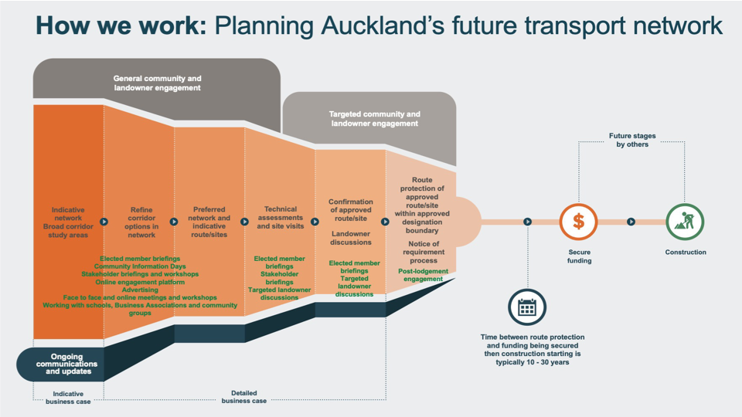
Attachment 5 - Engagement summary

Slide 2
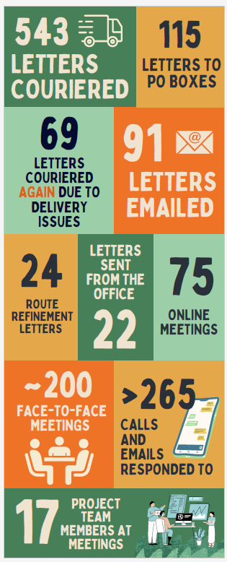
Engagement Summary cont…
Community and landowner engagement 11 July to 19 August 2022 on preferred routes. Advertising social media campaigns, project video and translation services.
‘Landowner first’ approach - letters to 1274 potentially impacted property owners and 30 face to face meetings.
Dairy Flat Hall – drop-in session – over 200 attendees.
241 responses - 58 (26.61%) survey submissions, and 160 (73.39%) were ‘drops’ on the interactive social map. 23 pieces of feedback by email.
686 landowners contacted as part of specific landowner engagement. We estimate we have met with around 35-40% of potentially impacted landowners. Many landowners do not want to meet.
Engagement with Local Boards, partners, stakeholders and landowners throughout the DBC and Notice of Requirement.
Communication with Watercare, Waka Kotahi, Auckland Council, Fire and Emergency NZ and Vector Limited about potential impacts to their properties.
The Rapid Transit Corridor attracted the most feedback – concern with proposed alignment.
Engagement with impacted landowners, key stakeholders and partners is ongoing and will continue post-lodgement as appropriate.
Lodgement communications and post-lodgement engagement late 2023.

