Slide 1
Attachment 1 - September 2023 Safety Business Report Dashboard
Safety, health and wellbeing dashboard
1.1. Safety, health and wellbeing FY24 critical success factors
1.2. Safety management system
1.3. Safety assurance and legal environment
1.4. Safety operational activity
1.5. Supplier management
Death and serious injuries (DSI) dashboard
2.1. DSI reporting
2.2. Fatalities reporting
2.3 DSI summary factors reporting
2.4 DSI local board reporting

Slide 2
1. Safety, health and wellbeing dashboard

Slide 3
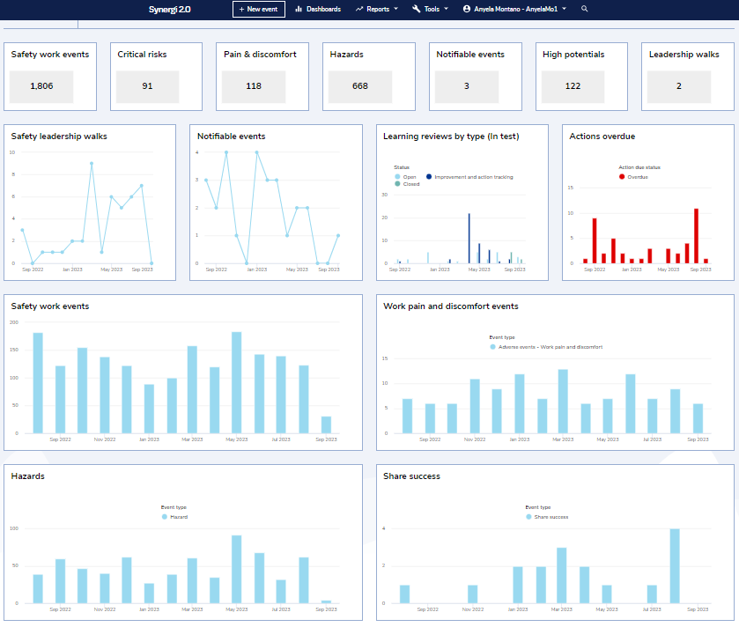
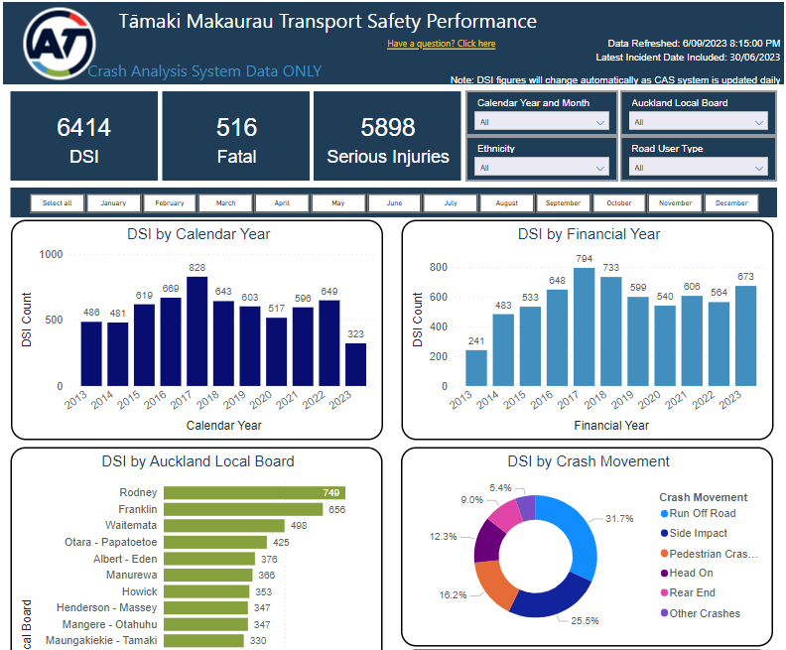
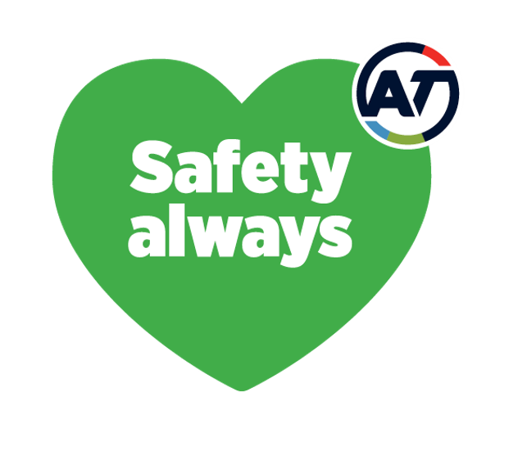
2021 Position
2023 Position
August 2023 reporting period – September update
1.1 Safety, Health and Wellbeing (SHW) FY24 critical success factors - Auckland Transport
Leadership
Safe Systems
Context: Leadership safety walks (LSWs) are an opportunity for senior leaders to directly engage with teams on the frontline. It is a methodology to undertake their due diligence or Health and Safety at Work Act (HSWA) 2015 officer duties. It also builds engagement and improves safety culture. Board members conduct one LSW per quarter and EGMs conduct 10 LSW per year. The programme is still to be rolled out to tier three people leaders. Work is underway to develop a role-specific capability framework based around the number of leaders attending Safety training.
Context: Design of Critical Safety Risk Framework, Transport Safety refreshed business case action plan and safety reporting will help to manage critical controls, transport safety outcomes and provide visibility and insights for decision making. These will be measured through progress on design of the Critical Safety Risk Framework and status of critical controls, status of actions plans completed (future), and growth in business units using Safety dashboards (future).
Critical Safety Risk Framework update
AT Critical Risk Procedure is being developed based on international best practice. The first draft will be ready for review by an external expert mid-September 2023.​ Progress on the existing Critical Risk Implementation and Verification Plan is on hold while a decision is made on how to progress this work​. Significant work is required on the existing critical risk bowtie models and controls, including the identification and management of critical controls.​
Transport safety strategy update
Scoping work has started with internal teams. Stakeholder liaison planned in the coming months.
Safety reporting update
Safety, Health and Wellbeing operational dashboards went live in Synergi and Transport Safety dashboards were launched in Power BI to a small stakeholder group. Knowledge sharing sessions have been organised for both and communication of the Transport Safety dashboards to the wider business is scheduled for September. Dashboards will help to identify trends and develop valuable insights for strategic decision making, planning and delivery.
Leadership Safety Walks update
Auckland Transport Operation Centre (ATOC) and parking officer LSWs completed (conducted and recorded in Synergi) by board and/or EGMs in August. Public transport driver LSWs completed by EGMs in July. We are supporting senior leadership teams in conducting and recording of leadership safety walks. Next EGM leadership safety walks scheduled for 20/09/2023
Role-specific capability framework update
Framework still underway.
Safety Synergi dashboards
Transport safety dashboards
Engagement
Context: Safety culture and leadership upskilling are measured as indicators of Safety engagement. Safety culture is measured by the Bradley Curve and reviewed annually supplemented by the quarterly AT Checking in Survey where four questions are analysed to understand the pulse of Safety. Upskilling of people leaders is measured by the number of simple/full learning reviews conducted by people leaders.
Safety culture update
Participation rates for the latest Dupont Safety Culture survey nearly doubled from 30% in 2021 to 58% in 2023. Increases in the relative culture strength were observed within Customer Experience, Service Delivery and Safety business units, and the AT Relative Culture Score (RCS) of 32 rose five basis points from 27 in 2021. Rail organisations in the international Dupont database average an RCS of 47. Leadership, recognition and belief in preventing injuries provide opportunity for improvement.
AT people upskilling update
Weekly upskilling drop-in sessions have been organised for learning reviews and Synergi operational dashboards. Invites for these drop-in sessions have been sent to the Safety Leader Council (SLC) members and Safety, Health and Wellbeing reps. They also are available through the Safety Hub for all employees. By attending a drop-in sessions and upskilling all employees we believe this will in turn improve our Safety Culture. The one-day Safety Leadership training course will recommence in October 2023 and will initially target members of the SLC.
Advocacy
Context: The Safety Advocacy Plan identifies the priority focus areas for policy and legislative changes to improve road safety outcomes across Tamaki Makaurau. The priority focus areas for 2023 are alcohol and drug enforcement, automated enforcement and review of motorcycle safety. These are long term priorities which will require Central Government support and commitment to achieve.
Advocacy plan implementation update
Meetings held with NZ Police and Waka Kotahi to advocate for higher roadside breath testing (RBT) targets in the next three year Road Safety Partnership Programme. Tamaki Makaurau Transport Safety Governance Group held, update from NZ Police on the sustained increased in RBTs across the region. Update provided on legislation to enable point to point cameras and oral fluid testing for impaired drivers. Letter sent from AT Board Chair to Commissioner of NZ Police in support of this increase and advocating for best practice levels over the next three years. Joint Marketing and Communications planning session held with Road to Zero partners to better align efforts and amplify effects of key activities. AT support of Motorcycle Awareness Month through the Community Partnerships team. Attended Road to Zero Deputy Chief Executive Group
Bradley Curve
Reactive
2021 Position
8
Dependent
2023 Position
6
Total Recordable Rate
Independent
4
2
Interdependent
0
40
60
Benchmark Best
20
80
100
Relative Culture Strength

Slide 4
August 2023 reporting period – September update
1.2 Safety management system (SMS) - Auckland Transport
AT SMS framework progress
Key initiatives
Context
The SMS framework is the foundation of AT’s health and safety system. It aligns with ISO 45001 and is essential to ensure professional management and innovation with safety across Auckland Transport.
There is significant work to be completed to ensure the SMS meets the required standard. Please note that the SMS activities listed on this slide are only part of the overall framework (under development).
Key progress and insights
The FY24 Work Programme is underway.
The core focus for this half of the financial year is health and safety risk management, including the development of risk and critical frameworks and learning module resources.
Key risks
The key risk for the AT SMS Framework is resource availability for development and implementation activities within the Safety team and across the organisation, especially in the context of the recent restructure. This is mitigated by effective prioritisation of the SMS activities.
Initiatives | Goal | Stage | Progress and insights | Risks
Critical risk | Development of framework to manage critical health and safety risks across AT and networks. | Development​ | AT Critical Risk Procedure is being developed based on international best practice. The first draft will be ready for review by an external expert mid-September 2023. Progress on the existing Critical Risk Implementation and Verification Plan is on hold while a decision is made on how to progress this work. | Significant volume of work and further resource may be required. Two-year timeframe, noting that critical risks will be reviewed on an ongoing basis.
Health and safety risk framework programme | Development of a framework for health and safety risk management across AT.​ | Development​ | SHW Risk Capability module on track. Safety Hub pages under development. Suite of support documents developed. | Engagement with business units on content of risk register.
Safety in procurement | Development of a Health and Safety Risk Management Standard for contract management.​ | Development​ | Waiting on feedback from internal teams. Content workshops have been completed between the Safety and Procurement teams. Session organised to progress to final stage. | Operational processes impacting delivery.
Person conducting a business or undertaking (PCBU) | Development of Contractor Health and Safety Management Framework.​ | Implementation​ | The PCBU implementation plan is currently being developed and will commence in 2024. New e-learning tools are readily available and are being mandated for all roles that manage or interact with PCBU’s. | Risk of legislative non-compliance.
MPOWER (worker engagement and representation in occupational health & safety) | Development of Worker Engagement, Participation and Representation Framework.​ | Implementation​ | The new MPOWER Lead has now onboarded. Focus for August was reviewing effectiveness of the MPOWER program. MPOWER Lead is meeting the Safety, Health and Wellbeing (SHW) representatives in their work setting to establish rapport, getting to know the different working environments. Focus is on engagement, coaching and mentoring and developing confidence within the MPOWER Program. | SHW reps engagement in the MPOWER Program
Safety Capability | Development of safety resources to increase knowledge and capability across AT.​ | Development​ | The Health and Safety Risk eLearning module build is underway, with the wireframe confirmed with the external designer. On track to launch this module in November 2023. Consideration is being given to potential topics for further modules (funding dependent). | Funding may impact the delivery of further work streams beyond the Safety, Health and Wellbeing Risk module.​
Performance Evaluation
Support
Operations
Planning
Leadership and work participation
Improvement
Proposed for AT’s SMS Framework

Slide 5
August 2023 reporting period – September update
1.3 Safety assurance and legal environment - Auckland Transport
Safety assurance review progress
Safety legal environment
Context
Safety assurance activities are conducted by safety subject matter experts. Safety assurance audits are currently carried out against the international best practice standard ISO 45001 Occupational Health and Safety, while our safety management system (SMS) continues to be developed and grows in maturity. The safety assurance process is currently an indication of the base line for future reference with flexibility to shift focus to key areas throughout the year. We are also identifying, designing and implementing solutions for areas we assess.
Key progress and insights
Figure 1 summarises the key findings and action types based on the relevant ISO45001 clauses.
The predominant area of concern is Clause 7 which covers resources, competence, awareness, communication and documented information.
Synergi tools for assurance activities are still in the developing stages, which includes safety conversations, ISO 45001 report form, facility inspection forms and project management assurance.
Key risks
A key part of the Leadership safety walks (LSWs) is recording the walks in Synergi. This assists in “closing the loop” with workers, and ensures actions are recorded and progressed. If LSWs are not recorded, a key piece of evidence is lost to demonstrate that officers and leaders are doing their due diligence, and abiding by the commitments made in the Safety, Health and Wellbeing Policy.
Key progress against Audit Plan
Context
Update on recent legal cases and other regulatory activity that may impact AT, including recommended actions where applicable.
Regulatory activity: WorkSafe NZ signaling greater focus on mentally healthy work
Each year, WorkSafe NZ releases a Te Kawa Tātai Mahi/Statement of Performance Expectations document. In the 2023/2024 release, WorkSafe signals the intention to spotlight work-related mental ill-health through the following activities:
taking firmer enforcement activity regarding mentally healthy work.
creating a specialist team focused on mentally healthy work and another team focused on investigating concerns related to mental health at work.
creating a dedicated notification form on its website for raising concerns about mentally unhealthy work.
collecting baseline data about adverse psychosocial factors at work in New Zealand.
WorkSafe is increasing their focus on mentally healthy work as mental ill-health accounts for 17% of all work-related harm in New Zealand (WorkSafe, 2023). Mental ill-health at work occurs as a result of uncontrolled psychosocial hazards such as bullying, harassment, violence and fatigue. If no intervention occurs, these occupational hazards can degrade an individual’s psychological wellbeing which can result in health-related outcomes such as stress, hypertension, gastrointestinal disorders, depression, anxiety, sleep disorders and suicidal ideation.
AT have identified psychological harm as a AT Critical Risk, supporting our focus and resourcing over the long-term to implement controls to prevent work-related harm occurring to our people.
Case law and legislation: Ruapehu Alpine Lifts Ltd (RAL)
RAL has been ordered to pay $433,094.82 in reparation to 17 victims involved in a RAL bus crash in 2018. One 11-year-old passenger was killed and many others were seriously injured. This case highlights the importance of regular vehicle maintenance and driver training – the bus brakes overheated and failed while descending the Ohakune Mountain Road and the driver made errors in response to the brakes failing. WorkSafe alleged that RAL knew the buses being used for this service were at the limit of their capability, and that drivers needed more in-depth training on the risk of brake failure in an alpine environment. RAL pleaded guilty to:
Failing to ensure so far as was reasonably practicable, the health and safety of other persons, namely passengers on its Mitsubishi Fuso buses were not put at risk from work (transport to and from the ski fields) carried out as part of the conduct of the business. This failure exposed passengers on the bus and other road users at the time to a risk of death or serious injury [HSWA s 36 (2); s 48(1)].
Failing to ensure so far as was reasonably practicable, the health and safety of workers who worked for RAL while they were driving the Mitsubishi Fuso buses. This failure exposed these workers to a risk a death or serious injury [HSWA s 36(1)(a); s 48(1); s 48 (2)(c)].
No fine was imposed by the court as RAL is in liquidation.
Type | Name | Key information
Internal | Authorisation to Work Process | Review conducted April 2023 Actions reviewed in August and further work to be done to close out.
Internal | Leadership Safety Walks (LSW) | ATOC and parking officer LSWs completed (conducted and recorded in Synergi) by board and/or EGMs in August. Public transport driver LSWs completed by EGMs in July. Actual walks completed: Board July-0/August-2 and EGM July-4/August-3 Approximately 50% of walks are conducted or recorded in Synergi for assurance activities. We are supporting senior leadership teams in conducting and recording of leadership safety walks. Next EGM LSWs scheduled for 20/09/2023 Leadership Safety Conversations and Leadership Safety Walks procedures for tier three people leaders have been developed waiting for approval.
Internal | Compliance Auditor Vehicle Review | Review undertaken in May 2023. Actions agreed and underway. Additional information is being sought from Auckland Council to follow up on progress.
Internal | Project Management Office (PMO) Review | Review conducted in November 2022. Actions stalled due to organisational consultation. Business Technology funding procured to implement filing system for organisational standardisation for safety record keeping. First draft of the filing structure guideline out for consultation, which allows for enterprise solution. Follow up actions planned for later this month.
4 - Context of organisation 5 - Leadership and worker participation 6 - Planning 7 - Support 8 - Operations 9 - Performance evaluation 10 - Improvement

Slide 6
August 2023 reporting period – September update
1.4 Safety operational activity - Auckland Transport
Activity update
Dashboard
Reporting period: September22-August23 from Synergi 2.0 system data
Context
Event management reporting provides confidence that AT is on top of health and safety, highlights areas for improvements and training, and helps manage safety risks. Classification of risk consequences are commonly misunderstood. For the benefit of all system users, the definitions to the right have been implemented.
36
Safety work events including near misses
Aug 2023
45
Hazards
Aug 2023
0
High potential event
Aug 2023
6
Safety events with a moderate risk consequence
Aug 2023
0
Notifiable safety events reportable to WorkSafe
Aug 2023
 | Injury​ | Ill-Health​
Extreme (21-25)​ | Multiple fatalities or long-term widespread health impacts. Includes notifiable incidents with potential for outcome​. | Multiple fatalities or long-term widespread health impacts​. Includes notifiable incidents with potential for outcome​.
Major (16-21 ) | LTI>14 days or life-threatening consequences​ and notifiable deaths. Includes notifiable incidents with potential for outcome. | Permanent disability or irreversible health problems from injury and occupational illness​, unlikely to return to work with significant modifications​. Includes notifiable incident with potential for outcome​.
Moderate (9 – 15)​ | LTI> One day and up to 14 days​. ​ | A diagnosed occupational illness case​ and moderate, minimal, local, or non-invasive intervention indicated up to severe but not immediately life threatening​.
Key progress and insights
There were no safety work events identified as high potential (major and extreme risk consequence) in August 2023.
Overall, in August 2023 over July 2023
Safety work events decreased 10% (Figure 1 and 4)
Hazards and work pain and discomfort increased 96% and 29% respectively (Figure 4)
Safety work events identified as critical risks decreased 42% (Figure 2)
Safety work events identified as critical risk in high-risk operational areas: Customer Experience (CX) down 33%, Service Delivery (SD) down 50% and Integrated Networks (IN) not up or down (Figure 5)
Total recordable injury frequency rate (TRIFR) and lost time injury frequency rate (LTIFR) increased 5% and 11% respectively due to an increase of 33% in the lost time injuries (4 to 3) and an increase of 13% in worked hours in August 2023 (Figure 6).
Key risks
Limited safety event reporting from all AT business units. We will continue to interact with these teams to better understand the factors that are preventing them from reporting and remediate.
People leaders not understanding their role in event management. A training program has been developed and is available on the Safety Hub.
People leaders not updating their teams Synergi cases within the agreed time period. The Safety team are working on an escalation process in Synergi to ensure people leaders update their cases within 48 hours as defined in the Event Management Procedure.

Slide 7
August 2023 reporting period – September update
1.4 Safety operational activity - Auckland Transport critical risks spotlight
Spotlight
Dashboard
Reporting period: September22-August23 from Synergi 2.0 system data
AT Critical Risks
Context
Health and safety work starts with identifying and understanding what AT’s work-related health and safety risks are. WorkSafe’s guidance is for businesses to focus on critical risks first before managing less serious risks.
Key insights
Violence, threats and aggression (VTA) were 80% of critical risk (CR) events from September 2022 to August 2023. The lowest number of safety work events were reported in CR5 working on an operational site (1%) and CR4 exposure to infectious diseases (0.3%) (Figure 1).
In August 2023: risk consequence heat map for indicates most safety work events identified as critical risks fell into the lower risk consequence (14) and five in the moderate risk consequence (Figure 2). The five were related to: three VTA with outcomes of Grade 4 (2) and Grade 1 (1), one working inside or outside of a vehicle on our network with property damage outcome and one exposure to psychological harm as a near miss.
In August 2023, 74% of the total of the reported safety work events presenting a critical risk to AT people were related to VTA, a decrease of two percentage points compared to July 2023 (76%) (Figure 3).
In August 2023, there were four critical risk outcomes that increased versus July: injury/illness, Grade 3 - Verbal Abuse (Sustained), Grade 5 - Intimidation and Threats (Verbally threaten to harm or kill) and Grade 6 - Intimidation and Threats (Non-verbal/verbal threat with weapon on display) (Figure 4).
Grade 4 - Intimidation and Threats (Threatening Behaviour) and Grade 1 - Verbal Abuse (Direct/Indirect Frustration Venting) were the outcome types with the most of safety work events reported from January to August 2023 (Figure 5).
Figure 2. August 2023 heat map - Risk consequence for safety work events identified as critical risks
19
Safety work events identified as critical risks | Cri |  | Likelihood
 |  |  | Rare May occur once in 20 years | Unlikely May occur once in 5-20 years | Possible May occur in 2-5 years | Likely May occur in the next 2 years | Almost certain May occur this year
 |  |  | 1 | 2 | 3 | 4 | 5
Consequences | Extreme | 5
 | Major | 4
 | Moderate | 3
 | Minor | 2 |  | 1-CR1 1-CR5 |  | 1-CR1
 | Insignificant | 1 |  | 1-CR3 | 9-CR1 | 1-CR1 1-CR3 | 2-CR1 1-CR2 1-CR3
Safety work events identified as critical risks
Aug 2023
Extreme (21-25) | Major (16-20) | Moderate (9-15) | Minor (4-8) | Insignificant (1-3)
Note: Psychological: Threats and aggression is an old field in Synergi that previously has not been classified by grades.

Slide 8
August 2023 reporting period – September update
1.5 Supplier management - Public transport (PT) operators and physical works (PW) contractors
Update on key notifiable or high potential events
PT dashboard
PW dashboard
Context
Public transport (PT) operators and physical works (PW) contractors report through Synergi notifiable events to the regulator, high potential events, and high potential near misses to ensure our suppliers have the highest level of protection against harm to their health, safety, and welfare from work risks so far as is reasonably practicable.
Reporting period: September22-August23 from Synergi 2.0 system data
Reporting period:September22-July23 from Synergi 2.0 system data and Microsoft list data
Regulator | Notifiable definition
WorkSafe for PT and PW | When as a result of works being undertaken, a death, notifiable illness or injury or notifiable incident occurs.
Maritime NZ for PT | Accidents, incidents and mishaps reportable to Maritime New Zealand in accordance with Section 31 of the Maritime Transport Act 1994 and Section 56 of the Health and Safety at Work Act 2015.
Waka Kotahi for PT | Accidents and incidents associated with the operation of a rail vehicle, the use of the railway infrastructure or the use of railways premises in accordance to Railways Act 2005 and Health and Safety at Work Act 2015.
High potential event definition
A situation or group of situations that has the potential to cause significant harm to person or property. These are normally viewed and approached as actual events, due to the severity rating. According to the AT Risk Matrix, high potentials are all events classified as Major (16 -20 ) or Extreme (21 -25).
Key insights*
Public transport operators
The MS form has been removed and all PT suppliers have started to report all notifiable and high potential events into Synergi in this reporting period.
In August 2023, there was no high potential events reported in Synergi.
There were a total of 19 notifiable events reported in August 2023 by AOR via their own system. The themes of the notifiable events were as follows: Rail crossing breaches, collisions with obstructions on lines and disorderly behavior.
Physical works contractors
There was no notifiable events reported by PW contractor in August 2023.
There was one high potential event reported in Synergi by PW contractor (STF Group) in August 2023. See slide 11 for details.
* It is possible for duplication of reported events between reporting methods. The next steps will focus on streamlining PW contractors’ processes, improving quality of data and presenting impactful insights.

Slide 9
August 2023 reporting period – September update
1.5 Supplier management - Public transport (PT) operators critical risks spotlight
Spotlight
Dashboard
PT Critical Risks
Context
Identification and management of PT critical risks is essential in ensuring our partners are operating safely, PT workers are protected from risk of harm and service users are not exposed to harm, as far as reasonably practicable. AT is working with all operators to eliminate or contain significant risks via consultation, cooperation and coordination with other persons conducting a business or undertaking (PCBUs).
Key insights
While 12 critical risks (CR) categories are identified for PT operators, seven categories have not been reported against from September2022 to August 2023 involving: CR2 terrorism, CR3 train services, CR4 fall from heights, CR5 confined spaces, CR7 exposure to hazardous substances and CR11 drowning (Figure 1).
CR6 violence towards staff (53%) and CR1 motor vehicle accident (39%) represent the largest percentage of critical risk events from September 22 to August 23 (total of 429 identified); The least number of safety work events identified as critical risks were CR12 contact with services (0.2%), CR8 traffic management (1%) and CR9 infrastructure (1%) (Figure 1).
In August 2023, 43% (10 of 23) of the total of reported safety work events were identified as the critical risk CR6 violence towards staff. There was a decrease of 63% (27 to 10) in safety work events classified as CR6 violence towards staff compared to July 2023 (Figure 2).
Property damage continued trending as the largest outcome for all safety work events identified as critical risks with 100 safety work events from January to August 2023. Although property damage has been increasing, there was a decrease of 23% (13 to 10) over July 2023 (Figure 3).
Injury/ illness was the only outcome that increased from 0 to 3 in August 2023 compared to July 2023 (Figure 3).
The risk consequence heat map for August 2023 indicates seven PT critical risks fall into the lower risk consequence and 16 PT critical risks fall into the moderate risk consequence (Figure 4).
Reporting period: August22-August23 from Synergi 2.0 system data
23
Safety work events identified as critical risks
Aug 2023
Figure 4. August 2023 heat map- Risk consequence for safety work events identified as critical risks
Safety work events identified as critical risks | Cri |  | Likelihood
 |  |  | Rare May occur once in 20 years | Unlikely May occur once in 5-20 years | Possible May occur in 2-5 years | Likely May occur in the next 2 years | Almost certain May occur this year
 |  |  | 1 | 2 | 3 | 4 | 5
Consequences | Extreme | 5
 | Major | 4
 | Moderate | 3
 | Minor | 2 |  |  |  |  | 1-CR1 1-CR10
 | Insignificant | 1 | 1-CR1 1-CR6 1-CR10 | 1-CR1 1-CR10 | 1-CR1 1-CR12 |  | 5-CR1 9-CR6
Extreme (21-25) | Major (16-20) | Moderate (9-15) | Minor (4-8) | Insignificant (1-3)

Slide 10
August 2023 reporting period – September update
1.5 Supplier management - Physical works (PW) contractors critical risks spotlight
Spotlight
Dashboard
PW Critical Risks
Context
Identification and management of PW critical risks is essential in ensuring our partners are operating safely, PW contractors are protected from risk of harm and are not exposed to harm, as far as reasonably practicable. AT is working with all contractors to eliminate or contain significant risks via consultation, cooperation and coordination with other persons conducting a business or undertaking (PCBUs).
Key insights
According to the risk consequence heat map for August 23, the majority of safety work events identified as critical risks fell into the lower risk consequence (3), however there were one safety work event as moderate and one as a major risk consequence (Figure 2).
The safety work event classified as moderate was related to CR4 assault towards team members with an outcome Grade 6 - Intimidation and Threats (Non-verbal/verbal threat with weapon on display) and the safety work event classified as major was related to CR6 working at heights with an outcome as near miss (see slide 11 for further details).
While 14 critical risk (CR) categories are identified for PW contractors, four categories have not been reported against from September 22 to August 23 involving: CR2 working in a live operating rail environment, CR5 confined spaces, CR9 working near or over water, and CR11 suspended loads (Figure 1)
CR4 assault towards team members, CR7 live services and CR1 working in live traffic environment maintained a consistent trend from the prior months and represented 26%, 19% and 14% respectively of critical risk events from September 22 to August 23. The least number of safety work events reported and identified as critical risks were CR10 chemicals spills (2%) and CR12 manual handling task (2%) (Figure 1).
In August 2023, there were five safety work events identified as critical risks being two related to CR4 assault towards team members, one CR3 working outside, one CR6 working at heights and one CR7 live services (Figure 3).
Violence/ aggressive behaviour / assault, collision with vehicles and underground services are the highest hazard category identified for the safety work events reported identified as critical risks from January to August 23 (Figure 4).
Reporting period: August22-August23 from Synergi 2.0 system data
Figure 2. August 2023 heat map - Risk consequence for safety work events identified as critical risks
5
Safety work events identified as critical risks | Cri |  | Likelihood
 |  |  | Rare May occur once in 20 years | Unlikely May occur once in 5-20 years | Possible May occur in 2-5 years | Likely May occur in the next 2 years | Almost certain May occur this year
 |  |  | 1 | 2 | 3 | 4 | 5
Consequences | Extreme | 5
 | Major | 4 |  |  | 1-CR6
 | Moderate | 3
 | Minor | 2
 | Insignificant | 1 |  | 1-CR7 | 1-CR3 | 1-CR4 | 1-CR4
Safety work events identified as critical risks
Aug 2023
Extreme (21-25) | Major (16-20) | Moderate (9-15) | Minor (4-8) | Insignificant (1-3)

Slide 11
August 2023 reporting period – September update
1.5 Supplier management - Public transport (PT) operators and physical works (PW) contractors
Key events in August 2023
Mode | Type | PTO | Key insights for notifiable events and high potential events
No notifiable or high potential events reported in Synergi for PT operators in the reporting period.
Rail | Notifiable to Waka Kotahi | AOR | August 2023 Nineteen notifiable events were reported. Nine of these were high potential near miss events. Six involved individuals crossing the tracks when signals were active for oncoming trains, two involved vehicles on the rail crossing when signals active, one was a member of the public (MOP) at the station. Remainder of notifiable events mostly involved collision into objects left on the line, one (0273) involved a MOP struck by train. Near miss with a person. Emergency brakes used. Car came onto the crossing with the train coming. Train was slowed down and horn was used. Female attempting self-harm. Police called and police left site taking the female with them. Near miss with 12 motorcycles all from the Headhunters Gang, crossing Church St level crossing around the barriers in front of the train. Train struck a shopping trolly under Jutland park footbridge. Train inspected by crew and no damage found. Domestic. Male hit female. Security took control. Police attended. Both arrested.
Mode | Type | PWC | Key insights for notifiable events and high potential events
No notifiable events reported for PW contractors in the reporting period.
Construction | High potential | STF Group | During a site safety review involving AT Health and Safety, two workers were observed working at heights without fall protection at Panmure Swing Bridge site. STF is the contractor. There were no injuries. We have requested the STF person in charge on-site, install some form of fall protection as soon as possible. Going forward, it is expected that where working at heights, STF will have qualified personnel to install the required fall protection and have the workers qualified to use it. We have confirmed that the issue was resolved the following day with the contractor engaging a certified fall protection company with the project safe work statements being revised to reflect the added control of a static line for workers to connect fall restraint harness to mitigate fall risk.

Slide 12
2. Death and serious injuries (DSI) dashboard
NOTE: Ministry of Transport (MOT) data will report a higher number of fatalities than the Crash Analysis System (CAS) and is to be noted when reviewing section 2.1 compared to section 2.2 of this report

Slide 13
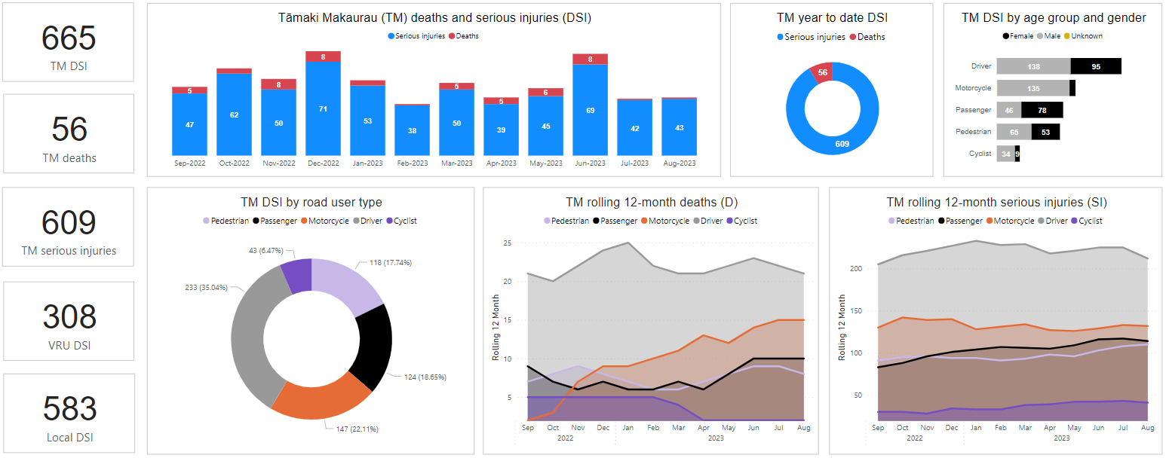
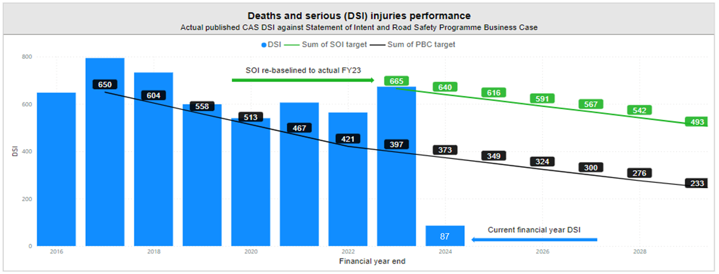
August 2023 reporting period – September update
2.1 Deaths and serious injuries (DSI) reporting
DSI update from Crash Analysis System (CAS)
Context
One of AT’s strategic focus areas is to make Tāmaki Makaurau’s transport system safe through the adoption of the Safe System approach and eliminating harm. The programme is divided into four CAPEX branches of high-risk intersections, high risk corridors, speed and vulnerable road users. OPEX component include enforcement, technology (e.g., speed and red-light cameras including monitoring), education, policy and operations (e.g., CAPEX land and fees and OPEX monitoring and maintenance).
Key progress and insights
665 people were killed or seriously injured on Tāmaki Makaurau roads in the last 12 months to August 2023:
56 people were killed and 609 were seriously injured
88% of DSI occurred on local roads
Drivers and motorcyclists remain the largest groups harmed on our roads, representing 57% of DSI. Motorcyclist fatalities continue to trend up, with a rise in serious inquiries for pedestrians, cyclist and passengers.
Largest crash movement types were run-off road (32%) and side impact (23%), with notably growing pedestrian crashes now representing 18% of crashes.
From the beginning of the year to August 2023, 410 people were killed or seriously injured, 16 more than the same time in 2022.
In August alone, three people lost their lives (One reported in CAS and two in Ministry of Transport data). One person was aged between 20-24, one was aged between 40-59 and one was aged over 60. One person died on a local urban road and two on state highways.
Growing insights: Self-serve transport harm dashboards were developed with CAS data and have been released to parts of the business, with wider release scheduled in September. Local board dashboard views have been developed to draw deeper localised insights for prioritization and decision making. A short-term resource has been approved to progress the next phase of transport harm insights with Accident Compensation Corporation (ACC) and Ministry of Health (MoH) data.
DSI performance targets: The new FY24 SOI target for Tāmaki Makaurau’s roads is no more 640 deaths and serious injuries. The target was realigned, baselined from the FY23 performance results to improve the correlation between the work plan, the actual budget and schedule.
Draft Katoa Ka Ora: public consultation closed 28th August 2023.
Key risks to Vision Zero
FY24 RLTP road safety funding has been reduced to 30 million from 74 million.
The cost to deliver has scaled between 20 and 40% post COVID-19, which means the delivery of programmes are compromised.
Death and serious injuries from Crash Analysis System (CAS)
Reporting period: September22-August23 from Crash Analysis System (CAS) data
Statement of Intent measure Crash analysis system (CAS)
Measure | Target DSI FY24 | Actual DSI FY24
Deaths and Serious Injuries on the road network in Tāmaki Makaurau | No more than 640 DSI by end of FY24 | 87 DSI Jul-Aug 2023

Slide 14
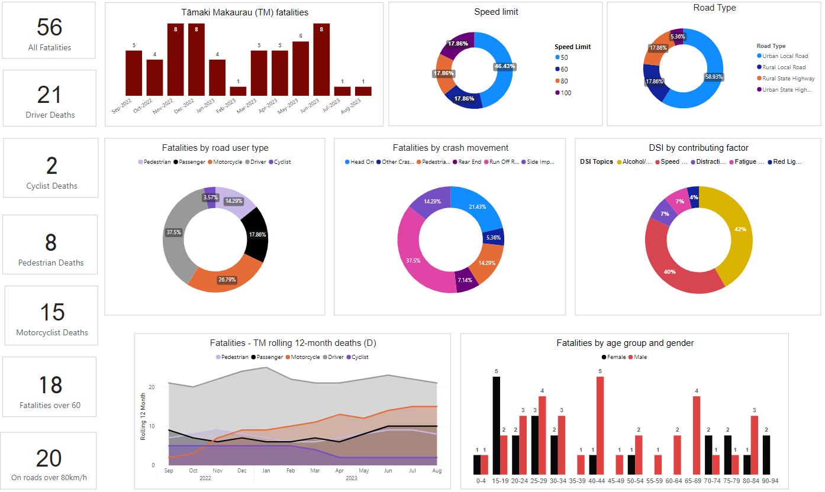
August 2023 reporting period – September update
2.3 Fatalities reporting
Fatalities update
CAS reporting on fatalities
Reporting period: September22-August23 from Crash Analysis System (CAS) data
56 people were killed on Tāmaki Makaurau roads in the last 12 months to August 2023 as recorded in CAS:
Driver fatalities remain the largest road user group.
77% of the 56 fatalities occurred on local (AT) roads.
The highest proportion of fatalities (38%) died in run off road crashes.
Howick had largest increase in fatalities (5), with 100% increases seen in side impact crashes (3) and pedestrian crashes (2) compared to same time in 2022 with no DSI in these crash types. Four were aged over 75years of age.
Out of the five contributing factor groups, fatalities related to speed and alcohol/drugs represent the largest contributing factors to the deaths.*
In August alone, three people lost their lives. One death was recorded in CAS and two additional deaths reported in the Ministry of Transport data (MOT - not included in graphs)
One aged between 20-24, one was aged between 40-59 and one was aged over 60.
One died on a local urban road and two on state highways.
*Crash related metric: contributing factors may have more than one contributing factors. Contributing factors – percentage (%) is across the contributing factors captured in the pie graph. It is not the percentage across all DSI
AT fatal crash reporting on local roads
Reporting period: January23-August23 from Road Safety Engineering Team
2023 Local road fatal crashes recorded in CAS
Safe roads | Safe speeds | Safe road user behaviour | Safer vehicles
Average road star rating (0%) Involved unprotected hazards (33%) Involved VRUs with insufficient infrastructure (33%) No primary treatment where urban fatality (69% of 16) | Do not align to safe speeds (57%) Exceeded posted speed limit (29%) | Alcohol confirmed (5%) Non-use of restraint where available (25% of 12) Drugs confirmed (0%) Distraction suspected (0%) Learner license (14%) Restricted license (19%) | Average vehicle star rating (3.2) No warrant of fitness (19%) Public transport involved (5%)
AT’s Road Safety Engineering team undertake fatal crash investigations in partnership with New Zealand Police. The primary focus of the AT team is to identify operational deficiencies that may have contributed to the cause of the fatal crash. The team identify defects and recommend remedial work that is required. The fatal crash report will also identify any safe systems gaps at fatal crash locations. The final report is submitted to the Police, and they use this in their report to the coroner.
There were 21 fatal crashes reported on local (AT) roads year-to-date (January – August 2023) with 30 recommendations for Safety Improvements on those roads, of which ten have been implemented and 19 remain open.

Slide 15
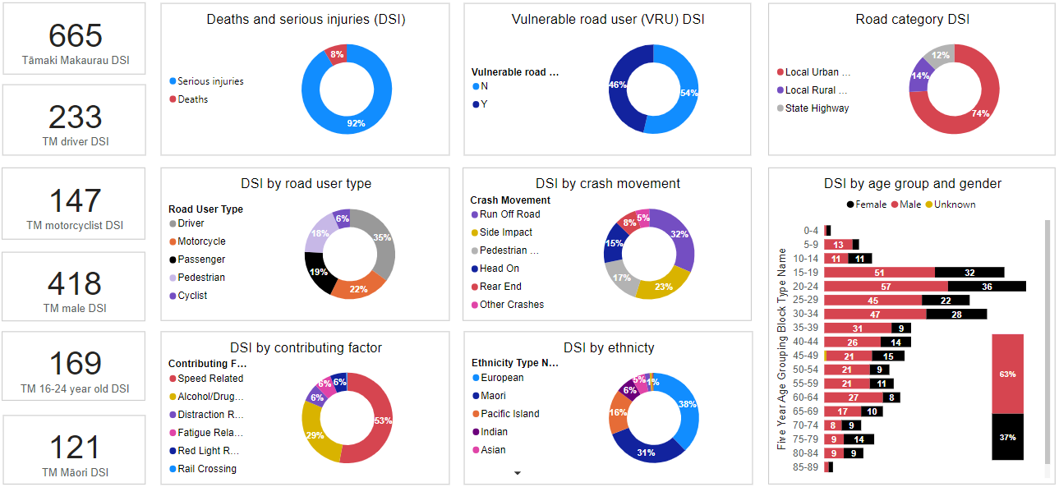
August 2023 reporting period – September update
2.2 Deaths and serious injuries (DSI) summary factors reporting
Summary factors update
Summary factors breakdown
Source: Crash Analysis System (CAS) data
Death and serious injuries from Crash Analysis System (CAS)
Reporting period: September22-August23 from Crash Analysis System (CAS) data
Last 12 months to August 2023:
Vulnerable road users represent 46% of deaths and serious injuries.
Men between 15 and 34 years of age are largest representation proportion in deaths and serious injuries; men represent 63%.
Run off road and side impact continue to be the most common crash movements.
Out of the six contributing factor groups, speed and alcohol/drugs represent the largest contributing factors to deaths and serious injuries.*
Māori represents 11% TM population and 31% of deaths and serious injuries.
Year to date January to August 2023 (YTD):
There were 410 people killed or seriously injured, 16 more than the same time in 2022.
Top three crash types: Run off road (108), side impact (102) and pedestrian crashes (80).
*Crash related metric: contributing factors may have more than one contributing factors. Contributing factors – percentage (%) is across the contributing factors captured in the pie graph. It is not the percentage across all DSI.

Slide 16
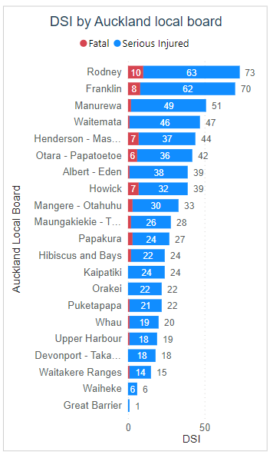
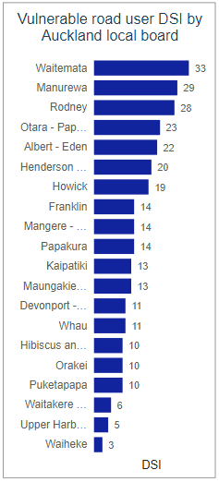
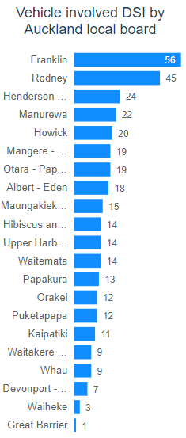
August 2023 reporting period – September update
2.4 Deaths and serious injuries (DSI) local board reporting
Local board update
Local board breakdown
Source: Crash Analysis System (CAS) data
Last 12 months to August 2023:
Rodney had the highest number of deaths and serious injuries (DSI) on Tāmaki Makaurau roads
Vulnerable road users (motorcyclists, pedestrians and cyclists): Waitemata had the highest DSI (59% of these at intersections)
Vehicle involved DSI (drivers and passengers): Franklin had the highest DSI

