Slide 1
Attachment 1 - March 2024​​ Safety Business Report Dashboard
Safety, health and wellbeing dashboard
1.1. Safety, health and wellbeing FY24 critical success factors
1.2. Safety management system
1.3. Safety assurance and legal environment
1.4. Safety operational activity
1.5. Supplier management
Death and serious injuries (DSI) dashboard
2.1. DSI reporting

Slide 2
1. Safety, health and wellbeing dashboard

Slide 3
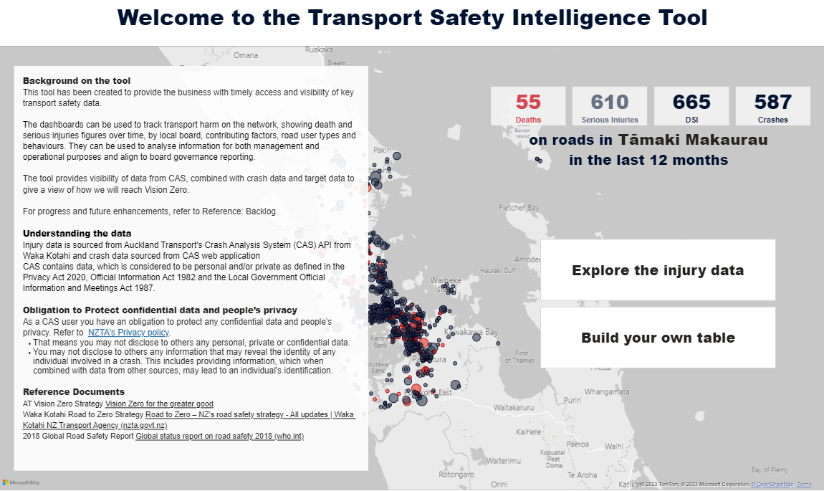
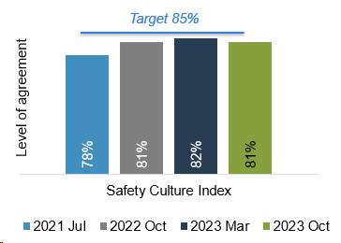
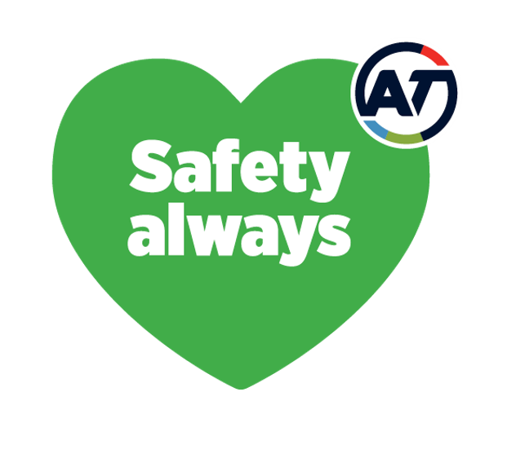
2021 Position
2023 Position
January and February 2024 reporting period - March update
1.1 Safety, Health and Wellbeing (SHW) FY24 critical success factors - Auckland Transport
Legend: | On track | On watch | Off track
Leadership – Safety, Heatlh and Wellbeing
Safe Systems – SHW and Transport Safety
Context: Leadership safety walks (LSWs) are an opportunity for senior leaders to directly engage with teams on the frontline. It is a methodology to undertake their due diligence or Health and Safety at Work Act (HSWA) 2015 officer duties. It also builds engagement and improves safety culture. Board members conduct one LSW per quarter and EGMs conduct 10 LSW per year. The programme is still to be rolled out to tier three people leaders. Work is underway to develop a role-specific capability framework based around the number of leaders attending Safety training.
Leadership Safety Walks update
Two Leadership Safety Walks were recorded for February 2024. A refresher training/update session is planned for the Executive Assistants (EA’s) in March 2024, so that they can begin booking LSW dates in.
Role-specific capability framework update
The discovery phase of the role-specific safety capability framework has commenced. The first output is to write an options paper outlining the possible approaches to this piece of work. Initial thinking is to complete a training needs analysis and build a skill/competency matrix; however, this needs to be positioned within the wider organisational context to ensure effort is not duplicated.
Context: Design of Critical Safety Risk Framework, Transport Safety refreshed business case action plan and safety reporting will help to manage critical controls, transport safety outcomes and provide visibility and insights for decision making. These will be measured through progress on design of the Critical Safety Risk Framework and status of critical controls, status of actions plans completed (future), and growth in business units using Safety dashboards (future).
Safety. Health & Wellbeing- Critical Safety Risk Framework update
The final draft of the Safety Critical Risk Framework is complete, including the foundation documents, visual maps and supporting resources. Training resources have been developed and peer reviewed by an external expert. The framework will be ready for implementation by the end of March 2024. The options for filling Critical Risk Owner and Critical Control Owner roles are being discussed with key audience groups throughout February and March 2024. Once these roles are confirmed, the Safety Critical Risk Framework will be completed and ready for launch.
Transport Safety - Strategy update
Work has begun to identify opportunities that align to the direction set through the Mayor's letter of expectation and central government direction. This will continue in early 2024 and will inform the revised safety investment strategy. The Transport Safety Tamaki Makaurau Governance Group met on 14th February 2024 to review 2023 progress and set the direction for 2024. The group will meet in March 2024 to discuss implications of the Government Policy Statement (GPS).
Transport Safety - Insights update
Accident Compensation Corporation investigation identified missing levels of data and we are awaiting updates. St Johns data request agreement has now been approved by both organisations and will be received in the next few weeks when we will model the raw data to the next stage. Investigation and further exploration of Ministry of Health data underway with no updates in February 2024. The status and priority of existing safety epics backlog, has been updated. We are working on two new epics, the Local Board dashboard, and a mapping of roadside hazards, starting with Vector power poles overlayed with deaths and serious injury crash data.
Transport dashboards
* Completed: conducted and recorded in Synergi 2.0
Engagement – Safety, Health and Wellbeing
Context: Safety culture and leadership upskilling are measured as indicators of Safety engagement. Safety culture is measured by the Bradley Curve and reviewed annually supplemented by the quarterly AT Checking in Survey where four questions are analysed to understand the pulse of Safety. Upskilling of people leaders is measured by the number of simple/full learning reviews conducted by people leaders.
Safety culture update
The program "Show us your day" is in a Pilot phase with Safety Leaders Council (SLC) members. Show us your days have been coordinated in February and will begin in March 2024. The aim is to cover all Business units by June 2024. This risk profiling and operational learning exercise places an SLC member in the environment of one of our frontline workers to enable them to understand the risks AT workers are exposed to everyday and understand the critical risk controls that are in place. This will make improvements to understanding the Safety Culture across AT The AT's Checking-In survey is coming up mid March 2024.
Advocacy – Transport Safety
Context: The Safety Advocacy Plan identifies the priority focus areas for policy and legislative changes to improve road safety outcomes across Tamaki Makaurau. The priority focus areas for 2023 are alcohol and drug enforcement, automated enforcement and review of motorcycle safety. These are long term priorities which will require Central Government support and commitment to achieve.
Advocacy plan implementation update
A review has been undertaken of the Safety Advocacy priorities for 2024, these will be discussed and confirmed at the Safety Committee meeting in March 2024. In the draft Government Policy Statement (GPS) the government has signaled a review of safety related fines and penalties (including demerit points) this was a key action identified in the 2021 business improvement review and has been the focus of advocacy efforts over the past few years.
Checking-in survey results 2021 -2023 Overall measure is based on all four survey questions

Slide 4
January and February 2024 reporting period - March update
1.2 Safety management system (SMS) - Auckland Transport
AT SMS framework progress
Key initiatives
Context
The SMS framework is the foundation of AT’s health and safety system. It aligns with ISO 45001 and is essential to ensure professional management and innovation with safety across Auckland Transport.
There is significant work to be completed to ensure the SMS meets the required standard. Please note that the SMS activities listed on this slide are only part of the overall framework (under development).
Key progress and insights
The FY24 Work Programme is underway. See details in the Key initiatives section.
The core focus for this year is health and safety risk management, including the development of risk and critical frameworks and learning module resources. This work is on track.
Key risks
The key risk for the AT SMS Framework is resource availability for development and implementation activities within the Safety team and across the organisation, especially in the context of the recent restructure. This is mitigated by effective prioritisation of the SMS activities.
Initiatives | Goal | Stage | Progress and insights | Risks
Critical risk | Development of framework to manage critical health and safety risks across AT and networks. | Development​ | The final draft of the Safety Critical Risk Framework is complete, including the foundation documents, visual maps and supporting resources. Training resources have been developed to support integration of the framework and have been peer reviewed by an external expert. The options for filling Critical Risk Owner and Critical Control Owner roles is being discussed with key audience groups throughout February and March 2024 The framework will be ready for implementation at the end of March 2024. | Significant volume of work and further resource may be required. Two-year timeframe, noting that critical risks will be reviewed on and ongoing basis. Obtaining engagement from other PCBUs to manage the public transport, physical works and member of the public safety critical risks.
Health and safety risk framework programme | Development of a framework for health and safety risk management across AT.​ | Development​ | The health and safety risk procedure is complete and will be published mid-March 2024. Collation of information for business unit risk registers to be included in the show us your day initiative. | Engagement with business units on content of risk register.
Safety in procurement | Development of a Health and Safety Risk Management Standard for contract management.​ | Development​ | Final draft has been completed and compiled into a single document, currently being reviewed by the Procurement Team. Phase two commenced February 2024 with a focus on building the supporting tools and resources for the safety in procurement processes. | Resource to complete the significant workload required to build the supporting tools and resources.
Person conducting a business or undertaking (PCBU) | Development of Contractor Health and Safety Management Framework.​ | Implementation​ | A Learning teams was facilitated with Eastern Busway (EBA) in February 2024. The theme of the Learning Teams was to find opportunities to reduce service strikes on the project. These learning outcomes will be shared with the wider Infrastructure and Place team. Following this, a learning team session will be held with AT Project Managers. Practical resources (e.g., How-to videos, meeting agenda/checklist) under development for internal staff to refer to and use when working with PCBUs. | Risk of legislative non-compliance.
Safety Capability | Development of safety resources to increase knowledge and capability across AT.​ | Development​ | The wireframe design of module four is completed, focusing on SHW Roles and Responsibilities and the specific requirements for various roles across AT. The module will be available across AT from the end of April 2024. The discovery phase of the development of a training needs analysis/competency matrix has commenced, with the aim of delivering these resources by the end of FY24. | Funding may impact the delivery of further work streams beyond the Roles and Responsibilities module.​
Performance Evaluation
Support
Operations
Planning
Leadership and work participation
Improvement
Proposed for AT’s SMS Framework

Slide 5
January and February 2024 reporting period - March update
1.3 Safety assurance and legal environment - Auckland Transport
Safety assurance review progress
Safety legal environment
Context
Safety assurance activities are conducted by safety subject matter experts. Safety assurance audits are currently carried out against the international best practice standard ISO 45001 Occupational Health and Safety, while our safety management system (SMS) continues to be developed and grows in maturity. The safety assurance process is currently an indication of the base line for future reference with flexibility to shift focus to key areas throughout the year. We are also identifying, designing and implementing solutions for areas we assess.
Key progress and insights
Safety assurance work programmes have largely been paused due to resource constraints (all safety assurance positions are currently vacant). The safety assurance programme will be revised by the incoming General Manager Health, Safety and Wellbeing from April 2024.
Flood recovery works after the weather events in February 2023 is ongoing, however a paper has been submitted to the Board to allow the HSW Team to step back from an immediate impact requirements and shift to a support as a required function.
Supporting the HSW Team to design key processes and documentation such as those relating to safety critical risk.
Refresh/training session planned for EA’s in March 2024.
Key risks
Currently all safety assurance roles are vacant.
A key part of the LSWs is recording the walks in Synergi. This assists in closing the feedback loop with workers, and ensures actions are recorded and progressed. If LSWs are not recorded, a key piece of evidence is lost to demonstrate that officers and leaders are doing their due diligence, and abiding by the commitments made in the Safety, Health and Wellbeing Policy.
Key progress against Audit Plan
Context: Update on recent legal cases and other regulatory activity that may impact AT, including recommended actions where applicable.
What it means for AT – Whakaari White Island sentencing
The prosecution of PCBUs involved in the Whakaari White Island disaster has concluded with sentencing on Friday 1 March 2024.
These cases are relevant to AT in terms of the management of contractors, their workers and PCBU relationships. AT must ensure that all workers (including contractors) and visitors/others are aware of the hazards and risks present, and when managing risks that could affect contractors, must consult, co-operate with and co-ordinate activities to prevent harm from occurring. These requirements are covered in AT’s PCBUs Working Together Framework.
Sentencing
In late 2020, WorkSafe laid 20 charges against 13 defendants for alleged failures to manage Whakaari’s volcanic risks before and during the December 2019 eruption that killed 22 people and critically injured 25. The PCBUs convicted have been sentenced as follows:
Whakaari Management Ltd (WML) – charged with failing to meet the primary duty of care to ensure the health and safety of others, Health and Safety at Work Act 2015 (HSWA) s.36(2). Fined $1.045m and ordered to pay $4.88m in reparation to all victims and families of the December 2019 eruption.
White Island Tours – charged with failing to meet the primary duty of care to ensure the health and safety of workers and others from the work it carries out, HSWA s36(1)(2). Fined $517,000 and ordered to pay reparation of $5m to the victims involved in its tours.
Volcanic Air Safaris - charged with failing to meet the primary duty of care to ensure the health and safety of workers and others from the work it carries out, HSWA s36(1)(2). Fined $506,000 and ordered to pay reparation of $330,000 to the victims involved in its tours.
Aerius Ltd (helicopter operator) - charged with failing to meet the primary duty of care to ensure the health and safety of workers and others from the work it carries out, HSWA s36(1)(2). Fined $290,000.
Kahu NZ Ltd (helicopter operator) - charged with failing to meet the primary duty of care to ensure the health and safety of workers and others from the work it carries out, HSWA s36(1)(2). Fined $196,000.
GNS Science – pleaded guilty to a charge of failing to meet the primary duty of care to ensure the health and safety of its workers, HSWA s.36(1). Fined $54,000.
Inflite Charters pleaded guilty and was sentenced in March 2022 - charged with failing to meet the primary duty of care to ensure the health and safety of others, HSWA) s.36(2). Fined $227,500 and ordered to pay court costs of $40,000.
Type | Name | Key information
Internal | Authorisation to Work Process | Review conducted April 2023. Actions reviewed in August 2023 and additional work needed to close out actions. Feedback provided on the follow up evidence provided. Nil updates
Internal | Leadership Safety Walks (LSW) | Two Leadership Safety Walks were completed in February 2024. Current Leadership Safety Walks fall significantly below the target of 12 per month. A refresh/training session is planned for the EA’s in Marcher 2024, so that they can begin to rebook LSW dates.
Internal | Project Management Office (PMO) Review | Review conducted in November 2022. Actions stalled due to organisational consultation. Business Technology funding procured to implement filing system for organisational standardisation for safety record keeping. First draft of the filing structure guideline out for consultation, which allows for enterprise solution. Awaiting restructure to see where the project lands. Based on the new structure this review may need to be permanently shelved, as there is no single owner. GM Safety to discuss. Nil updates

Slide 6
January and February 2024 reporting period - March update
1.4 Safety operational activity - Auckland Transport
Activity update
Dashboard
Context
Event management reporting provides confidence that AT is on top of health and safety, highlights areas for improvements and training, and helps manage safety risks. Classification of risk consequences are commonly misunderstood. For the benefit of all system users, the definitions to the right have been implemented.
Reporting period: March23-February24 from Synergi 2.0 system data
35
Adverse work events including near misses
Feb 2024
14
Hazards
Feb 2024
2
High potential adverse work events
Feb 2024
5
Adverse work events with a moderate risk consequence
Feb 2024
0
Notifiable adverse work events reportable to WorkSafe
Feb 2024
 | Injury​ | Ill-Health​
Extreme (21-25)​ | Multiple fatalities or long-term widespread health impacts. Includes notifiable incidents with potential for outcome​. | Multiple fatalities or long-term widespread health impacts​. Includes notifiable incidents with potential for outcome​.
Major (16-21 ) | LTI>14 days or life-threatening consequences​ and notifiable deaths. Includes notifiable incidents with potential for outcome. | Permanent disability or irreversible health problems from injury and occupational illness​, unlikely to return to work with significant modifications​. Includes notifiable incident with potential for outcome​.
Moderate (9 – 15)​ | LTI> One day and up to 14 days​. ​ | A diagnosed occupational illness case​ and moderate, minimal, local, or non-invasive intervention indicated up to severe but not immediately life threatening​.
Key progress and insights
In February 2024, there were two adverse work events identified as high potential (both major risk consequences) one related to violence, threats and aggression (VTA) where the AT staff was assaulted by a customer and one related to an AT staff working on an operational site sustained an injury from slipping on an uneven surface and twisted their ankle.
Overall, in February 2024 compared to January 2023:
Adverse work events increased by 9% (Figure 1 and 4)
Hazards decreased by 22% and work pain and discomfort events increased by 200% (Figure 4)
Adverse work events identified as critical risks increased 12% (Figure 2)
Customer & Network Performance (C&NP) was the only business unit that reported adverse work events identified as critical risk. It had an increase in reporting by 16% (Figure 5)
Total recordable injury frequency rate (TRIFR) and lost time injury frequency rate (LTIFR) increased by 3% and 5% respectively due to an increase of lost time injuries (zero to three) and a restricted work injury (zero to one). In addition, there was an increase of 8% in worked hours in February 2024 (Figure 6).
Key risks
Low levels of adverse work event reporting from all AT business units raise the possibility that AT's representation of safety occurrences may not be accurate. We'll continue to communicate to these teams to determine what the barriers are to reporting.
Due to the new structure, the business units name has been changed from November 2023.

Slide 7
January and February 2024 reporting period - March update
1.4 Safety operational activity - Auckland Transport critical risks spotlight
Spotlight
Dashboard
Reporting period: March23-February24 from Synergi 2.0 system data
AT Critical Risks
Context
Health and safety work starts with identifying and understanding what AT’s work-related health and safety risks are. WorkSafe’s guidance is for businesses to focus on critical risks first before managing less serious risks.
Key insights
In February 2024, there was an increase of 16% in the number of critical risks identified compared to January 2023 (25 to 29) (Figure 3).
Violence, threats and aggression (VTA) continues trending with the most critical risk (CR) events identified represented by 81% from March 2023 to February 2024. The lowest number of adverse work events were reported in CR5 working on an operational site (1.3%) and CR4 exposure to infectious diseases (0.3%) (Figure 1).
In February 2024, 83% (24 of 29) of the total of the reported adverse work events presenting a critical risk to AT people were related to VTA, an increase of seven percentage points compared to December 2023 (76%) (Figure 3).
In February 2024, there were two adverse work events identified as high potential and identified as critical risks (both major risk consequences) one related to violence, threats and aggression (VTA) and one related to working on operational site. However, the risk consequence heat map indicated most adverse work events identified as critical risks fell into the lower risk consequence (23) and four in the moderate risk consequence where three related to VTA with two outcomes Grade 8 - Assault (Actively hit) / Serious Assault (Sustained) and one near miss and one related to exposure to psychological harm with an outcome injury/illness.
In February 2024, there was a highly increase of adverse work events with an outcome Grade 2 - Verbal Abuse (Targeted but not sustained) (one to five) and injury/illness (three to five) (Figure 4).
Grade 4 and Grade 1 continue trending the highest outcomes types with the most of adverse work events reported from March 2023 to February 2024 (Figure 5).
Figure 2. February 2024 heat map - Risk consequence for adverse work events identified as critical risks
29
Adverse work events identified as critical risks | Cri |  | Likelihood
 |  |  | Rare May occur once in 20 years | Unlikely May occur once in 5-20 years | Possible May occur in 2-5 years | Likely May occur in the next 2 years | Almost certain May occur this year
 |  |  | 1 | 2 | 3 | 4 | 5
Consequences | Extreme | 5
 | Major | 4
 | Moderate | 3 | 1-CR2 |  | 2-CR1 1-CR3 | 1-CR1 1-CR5
 | Minor | 2 |  |  | 1-CR1
 | Insignificant | 1 | 1-CR1 | 5-CR1 1-CR3 | 11-CR1 1-CR2 | 2-CR1 | 1-CR1
Adverse work events identified as critical risks
Feb 2024
Extreme (21-25) | Major (16-20) | Moderate (9-15) | Minor (4-8) | Insignificant (1-3)

Slide 8
January and February 2024 reporting period - March update
1.5 Supplier management - Public transport (PT) operators and physical works (PW) contractors
Update on key notifiable or high potential adverse work events
PT dashboard
PW dashboard
Context
Public transport (PT) operators and physical works (PW) contractors report through Synergi notifiable events to the regulator, high potential events, and high potential near misses to ensure our suppliers have the highest level of protection against harm to their health, safety, and welfare from work risks so far as is reasonably practicable.
Reporting period: March23-February24 from Synergi 2.0 system data
Reporting period: March23-February24 from Synergi 2.0 system data and Microsoft Form data
Key insights
Public transport operators
In February 2024, there was no notifiable adverse work events reported.
In February 2024 , there were seventeen high potential adverse work events reported: eight related to (property damage) damage to bus operators' vehicles being, four were broken windows as a result of stones being thrown and two were seats damaged by sharp objects. There was also a bus stuck by a level crossing barrier arm when vehicle was stationary too close to the barrier. There continues to be significant VTA to bus operators and seven were notified; two Grade 8 notifications where the operators were physically punched, one Grade 7 where the operator was physically handled and four Grade 1 verbal abuse cases where the drivers refused to allow non-paying passengers. A ferry vessel was involved in a hard landing at a Pier resulting in damage to the vessel and Pier, there were no injuries, and a full investigation is ongoing.
Two significant near miss incidents were recorded: (1) Driver swerved in front of a moving bus causing the driver to take emergency action and (2) A recreational vessel circling a Fullers vessel at high speed near Hobsonville, Maritime Police informed.
In February 2024, AOR reported 19 notifiable adverse work events: Five Near miss events all relating to public being in rail corridor where emergency brakes and horn were applied. Four passed at danger (SPAD) events reported, in all cases the train was stopped but passed the signal. Two security breaches where trespassers were apprehended at Britomart and City Rail Link (CRL) tunnels. One member of the public was assaulted on a train at Newmarket station, Police were called. Two reports of Anti-social behavior (One on Southern line train with one at Mt Albert station). Three procedural breaches where on passengers were locked on trains that were not operational and had to be released where trains were parked at the end of service, with the other being where a service from the Strand had set off without a Transport Manager (TM) on board and needed to return to the Strand to collect a TM. The remaining event viewed on camera was at Glen Eden station where a blind passenger with a guide dog fell of the platform onto the track due to his guide dog edging him too close to the edge. The blind passenger was helped off the track by a member of the public, then both left the station.
Physical works contractors
In February 2024, there was no notifiable adverse work events reported, however, in January 2024, there was one notifiable event, a Ventia work crew was undertaking drainage works on the road shoulder with a 5.5T excavator. The injured person (IP), (who was also the spotter), had moved into the exclusion zone directly behind the excavator, to rake aggregate in the swale drain, The IP's safety boot prevented serious harm. The excavator reversed a short distance & run over the IP's left foot.
In February 2024, there were two high potential adverse work events, both were service strikes:
While installing drainage asset on Station Road, Excavator found unknown service underground and resulted in damaging the service. Later it was identified as chorus service which was not recorded on any service plans.
Overhead power cable struck causing power outage to one house. Operator was not aware the cable had been struck until the resident informed them that they had no power. Power reinstated five hours later. No injury or harm to persons in the vicinity.
Next steps will focus on streamlining PW contractors’ processes, improving quality of data and presenting impactful insights.
It is possible for duplication of reported adverse work events between reporting methods.
Definitions
Regulator | Notifiable definition
WorkSafe for PT and PW | When as a result of works being undertaken, a death, notifiable illness or injury or notifiable incident occurs.
Maritime NZ for PT | Accidents, incidents and mishaps reportable to Maritime New Zealand in accordance with Section 31 of the Maritime Transport Act 1994 and Section 56 of the Health and Safety at Work Act 2015.
NZTA for PT | Accidents and incidents associated with the operation of a rail vehicle, the use of the railway infrastructure or the use of railways premises in accordance to Railways Act 2005 and Health and Safety at Work Act 2015.
High potential adverse work event definition
A situation or group of situations that has the potential to cause significant harm to person or property. These are normally viewed and approached as actual events, due to the severity rating. According to the AT Risk Matrix, high potentials are all adverse work events classified as Major (16 -20 ) or Extreme (21 -25).

Slide 9
January and February 2024 reporting period - March update
1.5 Supplier management - Public transport (PT) operators critical risks spotlight
Spotlight
Dashboard
Reporting period: March23-February24 from Synergi 2.0 system data
PT Critical Risks
Context
Identification and management of PT critical risks is essential in ensuring our partners are operating safely, PT workers are protected from risk of harm and service users are not exposed to harm, as far as reasonably practicable. AT is working with all operators to eliminate or contain significant risks via consultation, cooperation and coordination with other persons conducting a business or undertaking (PCBUs).
Key changes in reporting
The new module in Synergi ’Supplier adverse event’ has been used for our suppliers for four months and it has evidenced a drop in adverse work events identified as critical risks as our PT operators are required to only report high potential (major and extreme risks) and notifiable adverse work events.
Key insights
In February 2024, there were nine high potential adverse work events reported. Seven were related to violence towards staff with four outcomes as property damage, two Grade 8 - Assault (Actively hit) / Serious Assault (Sustained) and one Grade 7 - Assault (Physical contact/touch/object thrown/push/shove/minor assault); and two related to motor vehicle accident with one outcome as property damage and one near miss (Figure 4).
CR6 violence towards staff (62%) and CR1 motor vehicle accident (31%) represent the largest percentage of critical risk events from March 2023 to February 2024 (total of 295 identified); The least number of adverse work events identified as critical risks were related to CR12 contact with services (0.3%) and CR7 Exposure to hazardous substances (0.3%) (Figure 1).
Overall, in February 2024 compared to January 2024:
Adverse work events identified as critical risks increased by 125% (four to nine) (Figure 2)
78% of the total reported adverse work events identified as critical risks were related to violence towards staff and 22% to motor vehicle accident (Figure 2).
Violence towards staff events increase 75% from four to seven (Figure 2).
Grade 7 - Assault (Physical contact/touch/object thrown/push/shove/minor assault) (four to one) was the only outcome that decreased and property damage was the outcome that increased the most (zero to five) (Figure 3).
9
Adverse work events identified as critical risks
Feb 2024
Figure 4. February 2024 heat map- Risk consequence for adverse work events identified as critical risks
Adverse work events identified as critical risks | Cri |  | Likelihood
 |  |  | Rare May occur once in 20 years | Unlikely May occur once in 5-20 years | Possible May occur in 2-5 years | Likely May occur in the next 2 years | Almost certain May occur this year
 |  |  | 1 | 2 | 3 | 4 | 5
Consequences | Extreme | 5 |  | 1-CR6 | 2-CR1 1-CR6 |  | 1-CR6
 | Major | 4 |  |  |  |  | 1-CR6
 | Moderate | 3 |  |  |  | 1-CR6 | 2-CR6
 | Minor | 2
 | Insignificant | 1
Extreme (21-25) | Major (16-20) | Moderate (9-15) | Minor (4-8) | Insignificant (1-3)

Slide 10
January and February 2024 reporting period - March update
1.5 Supplier management - Physical works (PW) contractors critical risks spotlight
Spotlight
Dashboard
PW Critical Risks
Context
Identification and management of PW critical risks is essential in ensuring our partners are operating safely, PW contractors are protected from risk of harm and are not exposed to harm, as far as reasonably practicable. AT is working with all contractors to eliminate or contain significant risks via consultation, cooperation and coordination with other persons conducting a business or undertaking (PCBUs).
Key changes in reporting
The new module in Synergi ’Supplier adverse event’ has been used for our suppliers for four months and it has evidenced a drop in adverse work events identified as critical risks as our PW contractors are required to only report high potential (major and extreme risks) and notifiable adverse work events.
Key insights
In February 2024, adverse work events identified as critical risks remained steady compared to January 2024 (two to two) (Figure 3).
In February 2024, there were two high potential adverse work events reported. One related to CR4 assault towards team members with an outcome Grade 9 - Serious and Severe Assault and one related to CR7 live services with a property damage outcome (Figure 2).
CR4 assault towards team members and CR7 live services continue representing the largest percentage of critical risk events from March 2023 to February 2024 representing 29% and 21% of adverse work events reported and identified as critical risks, respectively. The least number of adverse work events reported and identified as critical risks were CR10 chemicals spills and CR6 working at heights representing 3% each respectively (Figure 1).
Violence/ aggressive behaviour / assault, is the highest hazard category identified for the adverse work events reported identified as critical risks from March 2023 to February 2024 (Figure 4).
Reporting period: March23-February24 from Synergi 2.0 system data
Figure 2. February 2024 heat map - Risk consequence for adverse work events identified as critical risks
2
Adverse work events identified as critical risks | Cri |  | Likelihood
 |  |  | Rare May occur once in 20 years | Unlikely May occur once in 5-20 years | Possible May occur in 2-5 years | Likely May occur in the next 2 years | Almost certain May occur this year
 |  |  | 1 | 2 | 3 | 4 | 5
Consequences | Extreme | 5
 | Major | 4 |  |  | 1-CR4 1-CR7
 | Moderate | 3
 | Minor | 2
 | Insignificant | 1
Adverse work events identified as critical risks
Feb 2024
Extreme (21-25) | Major (16-20) | Moderate (9-15) | Minor (4-8) | Insignificant (1-3)

Slide 11
2. Death and serious injuries (DSI) dashboard
NOTE: Ministry of Transport (MOT) data will report a higher number of fatalities than the Crash Analysis System (CAS) and is to be noted when reviewing section 2.1 compared to section 2.2 of this report

Slide 12
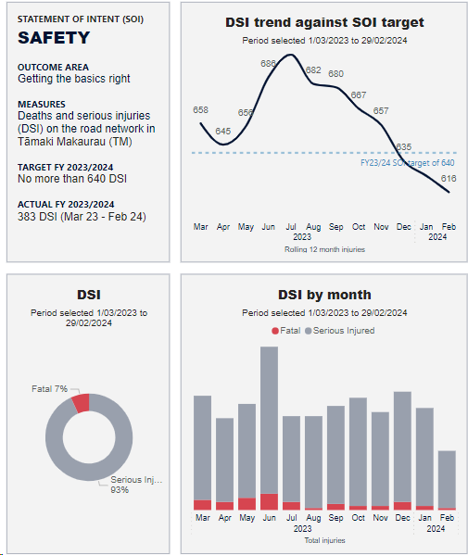
January and February 2024 reporting period - March update
2.1 Deaths and serious injuries (DSI) reporting
Transport safety progress
Key insights
Context
Tāmaki Makaurau’s commitment to Vision Zero is an ambitious transport safety vision with the goal of no deaths or serious injuries on our transport network by 2050. This strategy is aligned with the Auckland Plan 2050.
The draft Government Policy Statement (GPS) on Transport reaffirms the governments commitment to safety, Road safety is a responsibility we all share, and improving road safety in an efficient manner is a priority for this Government. The initial opportunities we see for delivering Vision Zero through this GPS are in continuing to partner strongly with NZ Police, advocating for the review of safety related fines and penalties, delivering fit for purpose safety infrastructure and targeting road safety education efforts. We will be engaging with our road safety partners over the next month to better understand these opportunities, this will then feed into our updated joint action plan.
Key progress
Growing insights: Safety Intelligence Tool continues to be enhanced for the business to improve data insights. Investigation into ACC and MoH data is being progressed, with St John’s data feed approvals now in place with the BT and Transport Safety Team, next steps will be to model the raw data.
Fatal crash reporting: A fatal crash dashboard showing key themes and safe system gaps is now operational. There were 32 fatal crashes reported on local (AT) roads 2023/24 with 39 recommendations for Safety Improvements on those roads. Of these, 32 have been implemented and 7 remain open.
On Katoa, Ka Ora: draft speed management plan, the board and DDC has endorsed proposed changes related to schools, marae and Karioitahi Beach and other strongly supported roads being taken to the Regional Transport Committee for a decision.
Key risks to Vision Zero
The draft GPS on Transport moved the infrastructure component from the safety activity class to local road improvements. This will mean funding for safety infrastructure will be limited due to competing priorities.
The Statement of Intent (SOI) deaths and serious injuries (DSI) target on the road network in Tāmaki Makaurau is on track which is no more than 640 DSI by end of the financial year 2023/2024.
Overall DSI insights (past 12 months from March 2023 to February 2024)
616 people were killed or seriously injured on Tāmaki Makaurau roads compared to 648 the previous year, a decrease of 5% year-on-year, where 42 people were killed and 574 were seriously injured.
88% of deaths and serious injuries occurred on Auckland Transports local roads.
48% of reported deaths and serious injuries are experienced by people outside of vehicles (people walking, people cycling and motorcyclists).
Males account for 67% of DSI and the remaining 33% are females.
The highest proportion of deaths and serious injuries at 28% were seen in the 15-24yr age group, which represents 12.8% of Tamaki Makaurau’s population.
Māori represents 11% of Tāmaki Makaurau’s population and 18% of deaths and serious injuries (43% of DSI ethnicities are recorded as unknown).
Crash attribute insights
Side impact and run off roads crash movement types are the most common, and on our local roads represent 27% and 24% respectively.
Death and serious injuries from Crash Analysis System (CAS)

Slide 13
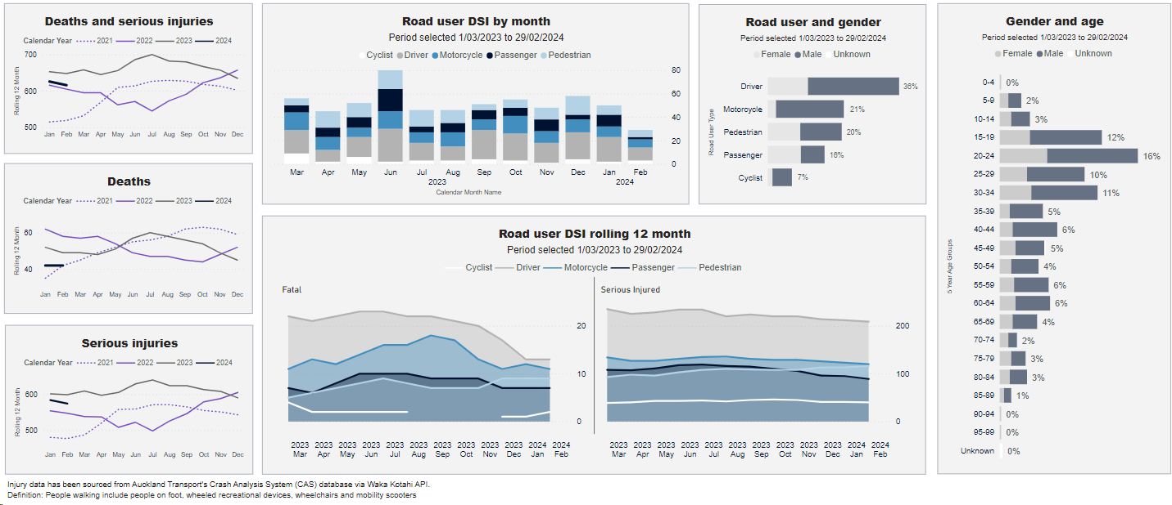
January and February 2024 reporting period - March update
2.1 Deaths and serious injuries (DSI) reporting
Road user DSI dashboard
Death and serious injuries from Crash Analysis System (CAS)

Slide 14
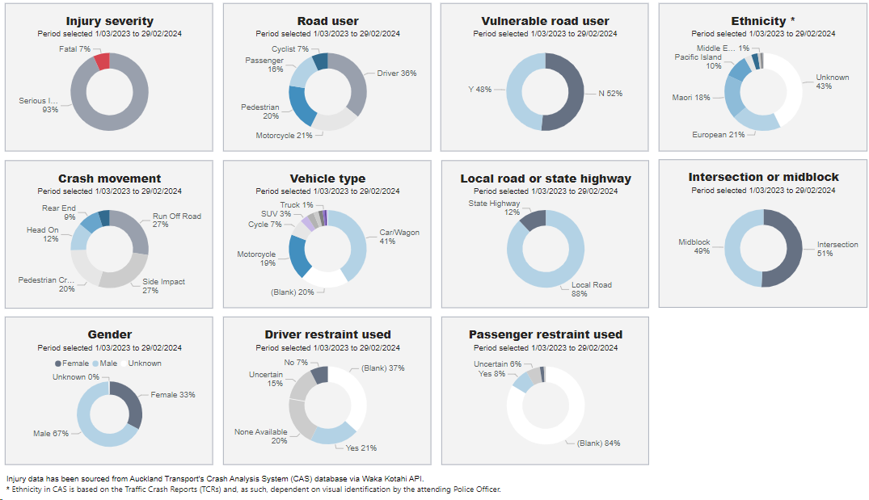
January and February 2024 reporting period - March update
2.1 Deaths and serious injuries (DSI) reporting
Summary factors DSI dashboard
Death and serious injuries from Crash Analysis System (CAS)

Slide 15
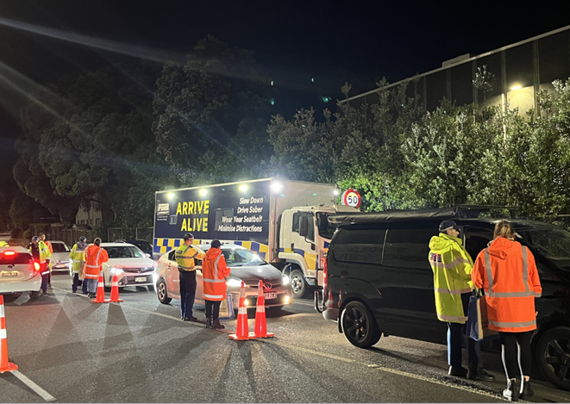
January and February 2024 reporting period - March update
2.1 Deaths and serious injuries (DSI) reporting
Responding to Alcohol related crashes
Key insights
Alcohol impaired and tested above the legal limit is a factor in 14% of DSI crashes each year in Tāmaki Makaurau. This increases to 30% when looking only at fatal crashes.
Analysis of drink driving rates in Auckland estimates around 3% of drivers were over the limit during high-alcohol hours on Friday and Saturday nights in FY 21/22.
Key to reducing the impact of drink driving on our network is effective Police enforcement. AT have been advocating for an increase in roadside breath testing since 2019, there has been a significant lift in the number of tests over the past 18 months.
Over 825,000 breath tests completed across the region in 2023, this is the highest number of tests in the past 10 years.
Interim results for 2023 show a reduction in alcohol related crashes for the third year in a row.
In support of enforcement our Community Transport team partner with communities to deliver recidivist drink driver programmes, host responsibility for clubs and groups that provide alcohol and incorporate sober driver messaging into young driver and community education.
Drink Free Summer
Over summer 23/24 we partnered with NZ Police to raise awareness of the increased amount of road side breath testing happening across the network. Our joint message was to let drivers know this was happening, to influence their decision making prior to drinking and provide alternative options for getting home safe.
This partnership included joint operations with AT staff supporting NZ Police at their checkpoints, shared social media posts, media releases and messaging to businesses.
While we are awaiting the final evaluation of this project interim results show a reduction in alcohol related crashes and record-high levels of roadside breath testing across Tāmaki Makaurau
At an impairment checkpoint in Counties Manukau on 08/03/24, a driver politely enquired if the police budget for road policing had increased as the driver had been stopped several times since Christmas and was being more ‘careful’ as a result.

