Slide 1
Attachment 4 - How costs may be shared in the future
  Opportunities to align with developers are expected to cover 25% of the value of the network for the AT projects.
  Early route protection helps enable this by securing the route and third-party land where needed to deliver.
  This reduces AT’s and Waka Kotahi’s share towards these AT projects.
AT and Waka Kotahi total network cost
$6.4 billion

Slide 2
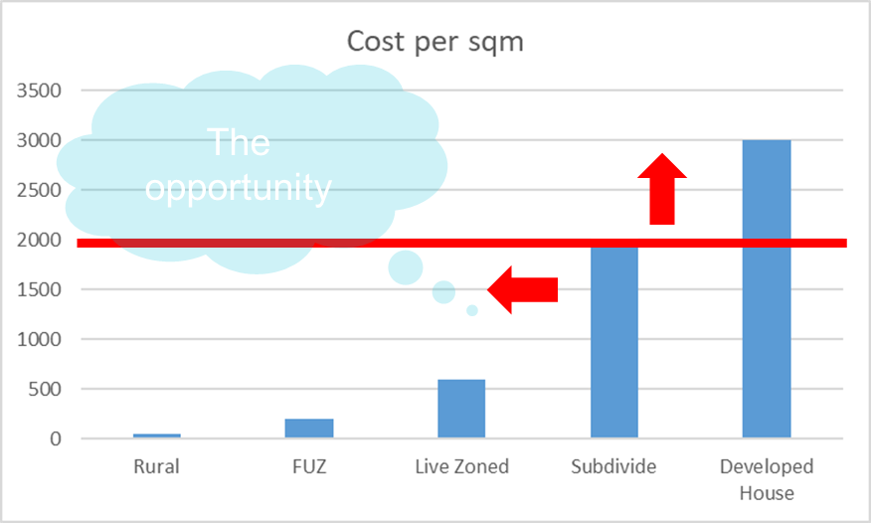
Affordability of route protection and property
Total AT cost if designated now - $2.5 billion
Total AT cost if not designated - $3.2 billion
Savings - $700 million
Can we afford not to?​
Not route protecting could increase costs by 33%​
5-10% construction saving in the order of $300-600 million
The earlier we acquire land the more we save​
Avoid social impacts and costs by planning of growth
AT total cost $2.5B, Property $204M*, Property hardship to 2031 $37M
* Un-escalated P50 cost for both AT and WK
Property increase in value as land is developed
Property escalation compounds overtime
Delivery
Hardship

