Slide 1
Attachment 2 – DBC Multi Criteria Analysis
IBC preferred options (2019) as starting point for DBC – whole network retested.
Key considerations in reaching an emerging preferred network:
  Physical form of grade separation.
  Number and location of crossings.
  Modes to be accommodated at each crossing (eg vehicles, people walking or on bikes).
  Does not consider speculative mitigation options
This involved expert assessment, AT/ Waka Kotahi requirements, Manawhenua and KiwiRail feedback, and feedback from the community.
Consideration of previous expert assessments including form and location of crossings (studies dating back to 2006).
2021
2022
2022
2023
Initial consideration of physical form of grade separation – road up vs road down vs rail up vs rail down
Scenario-based optioneering (MCA) – to identify number / location of grade-separated crossings
Emerging preferred network – preferred number / location of grade-separated crossings
Consideration of physical form of grade-separation – bridge vs underpass MCA
Recommended network – number, location, and physical form of crossings
Further retesting of physical form in light of Board direction and new information
Reconfirmation / validation of recommended network
Public engagement – Aug-Sept 2022
Public engagement – Nov-Dec 2022
Public engagement – June 2023

Slide 2
Physical form of grade separation – late 2021-early 2022
Form of grade-separation |  | Key considerations
Rail grade changes | Rail-over-road (rail viaduct) | Rail gradients require ~1km ramping up or down to achieve required vertical clearances above or below ground. Not possible to grade-separate rail at Spartan Road given proximity of SH1 interchange and Papakura Stream. 3.7km-long structure would be required to clear Manuroa, Taka, and Walters; only Walters could be done in isolation. Highest disruption, visual effects (in the case of a viaduct), and costs – discarded prior to shortlisting.
 | Rail-under-road (rail tunnel)
Road grade changes | Road-over-rail (road bridge) | Key geometric parameters – gradients, clearances over rail, bridge deck width, ability to future-proof for rail four-tracking. Need to maintain access to adjacent properties via access lanes. Preferred in initial assessment – retested subsequently.
 | Road-under-rail (road underpass) | Broadly similar geometric parameters to a bridge, but greater land take required to accommodate temporary rail diversion during construction, and to allow space for settlement mitigation. Higher costs, complexity, risk; resilience concerns (see next slide). Preferred construction methodology includes temporary rail diversion requiring additional property. Alternatively, prolonged closure of the rail is required. Not preferred in initial assessment – retested subsequently.

Slide 3
Physical form options – Walters Road
Criteria | Bridge (B) | Preference |  | Underpass (U)
Investment objectives​ | Meets investment objectives in terms of transport safety, choice, resilience, and accessibility. | B |  | Same performance as bridge from a transport perspective, but resilience concerns given potential underpass flooding.
Property​ requirements | <20 full property acquisitions required (largely industrial premises west of the rail), numerous partial/frontage impacts, effects on property access. | B |  | Similar property footprint to a bridge, but an underpass will require additional property to accommodate temporary rail diversion during construction, and to allow space for ground settlement mitigation.
Urban design​ | Neutral impact – negative local visual impact of a bridge balanced out by positive effect of east-west connectivity and reduced severance. | B |  | Same positive effects as a bridge for east-west connectivity – however poorer CPTED outcomes / personal security risks for active mode users.
Landscape/ visual​ | Moderate-high visual impacts (without mitigation) in context of commercial and residential surroundings​; moderate impacts with mitigation (e.g. planting). |  | U | Underpass will have less visual impact than a bridge, but will still have localised visual effects/will represent a new feature in the environment (i.e. a long road trench with a perpendicular rail bridge, prop beams etc).
Stormwater​ | Bridge will affect existing overland flow paths and require overland flow path diversion. | B |  | Underpass will require flood pumping and groundwater management (seepage pumping).
Natural hazards​ | Poor underlying ground conditions susceptible to settlement. Lesser risk for a bridge given structure is lighter and shallower than an underpass. | B |  | Poor underlying ground conditions susceptible to settlement. Greater risk for underpass given structure is heavier and deeper than a bridge. Additional flood resilience risk not present for a bridge.
Construction impacts on utilities​ | Impacts on local underground utilities, potential need to protect assets. Potential need to underground overhead powerlines. | B |  | As per bridge – plus would necessitate relocation of an existing stormwater pipe, local utilities and fibre cable not otherwise required for a bridge​.
Construction disruption | Works in an existing urban area and local disruption associated with bridge construction, particularly disruptions to local access and traffic associated with temporary road closures. | B |  | In addition to disruptions to local access and traffic associated with temporary road closures, the preferred construction methodology includes temporary rail diversion or alternatively prolonged closure of rail.
Construction cost/risk​ | Complex construction in a constrained area, ground conditions sensitive to additional loading. | B |  | Complex construction in a constrained area. Deep secant wall construction required for groundwater cutoff, anchoring in place required given completed structure below the groundwater table. Higher groundwater-related consenting costs.
Stakeholder/ community feedback​ | General support for removal of level crossings. Perceived negative visual impacts and loss of amenity value and business viability​ associated with bridge option. |  | U | General support for removal of level crossings. Perception that an underpass would be less impactful from an amenity and business viability perspective.

Slide 4
Reconfirmed Preferred option – bridge overpass
Based on expert assessment across multiple disciplines the overpass outperformed the underpass across 8 of 10 criteria.
The underpass does not deliver a resilient outcome: It is likely to flood in significant rainfall events, even with a pump system installed (i.e. due to power failure or stormwater systems being overloaded), resulting in the crossing being closed.
Significant disruption to NIMT: preferred construction methodology for an underpass requires temporary diversion of the existing rail line, increasing land requirements, construction complexity, and disruption. Alternatively, prolonged closure of the rail line is required.
The underpass requires additional land take/designation footprint to accommodate temporary rail diversion and allow for potential mitigation of ground settlement effects on existing buildings, including part of 30 Walters Road (Takaanini Town Centre).
This all adds to the impact and the complexity of construction and cost.

Slide 5
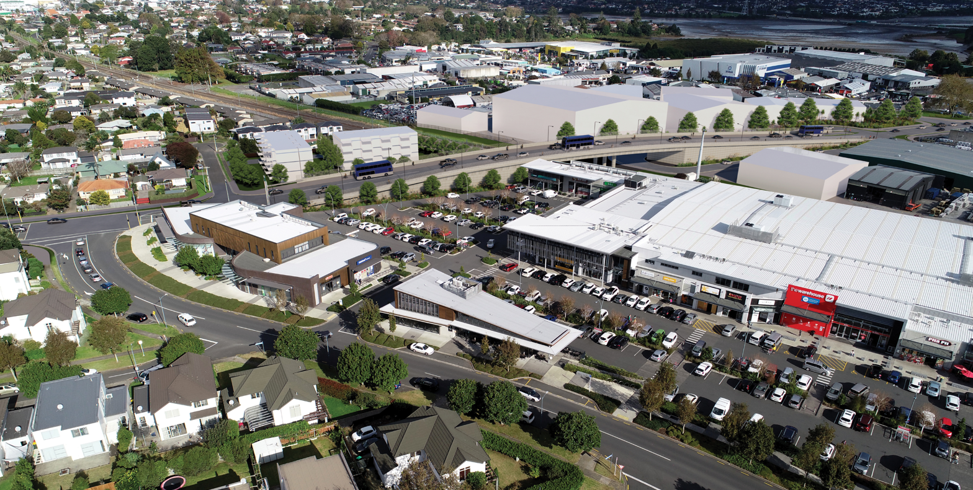
Walters Road
Walters Road Grade Separation – Aerial view looking South

Slide 6
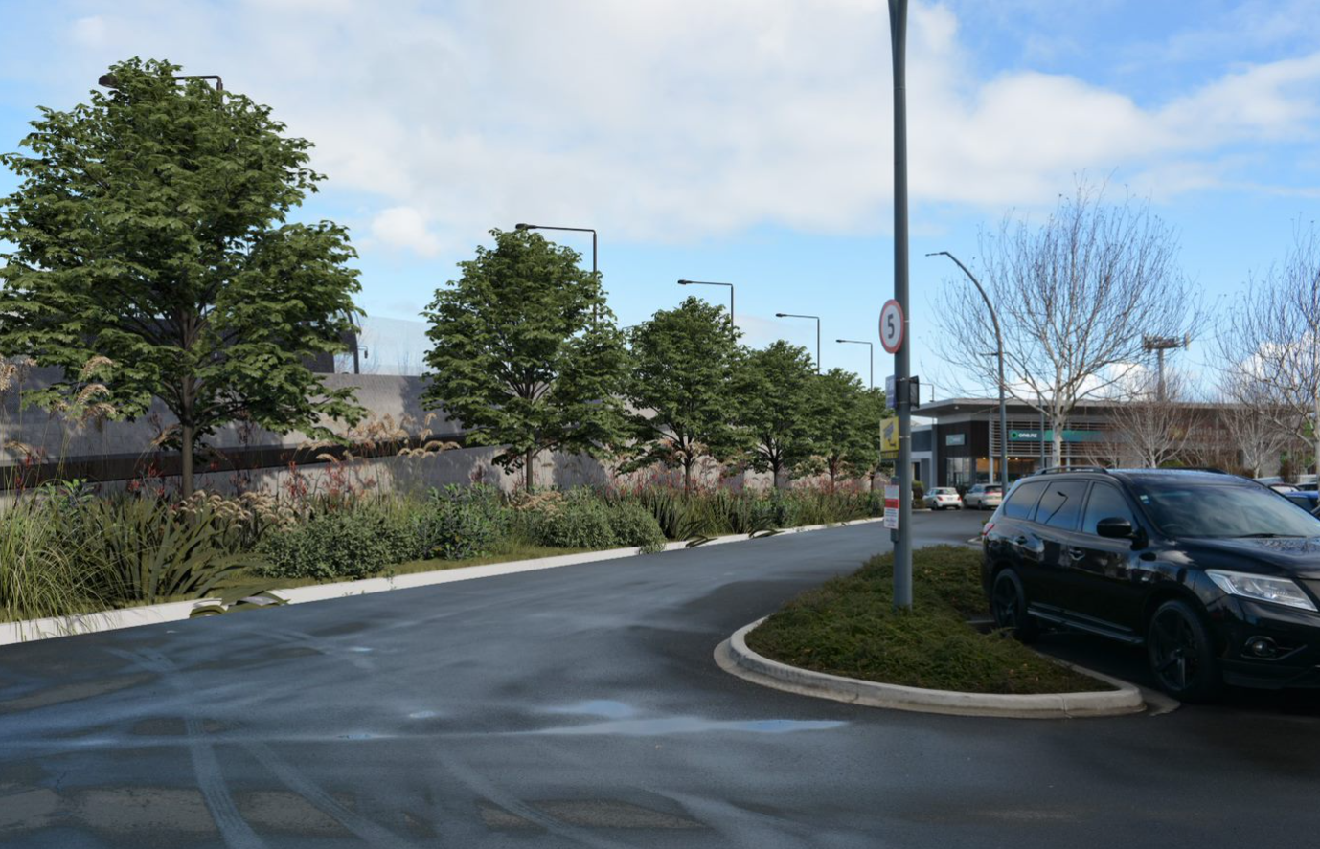
Walters Road
Walters Road with tree planting – looking west from town centre carpark

