Slide 1

Proposed Organisational Purpose & Strategy
Supporting presentation
August 2023

Slide 2
SOI
PWC Report
Auckland Plan
Existing Purpose & Principles
Vision for Joint Transport Plan
15 x SLT workshop all the inputs for the day.
All thinking consolidated into a one place. Landed purpose thought.
Our journey.
Now we design how we will articulate and communicate our purpose.

Slide 3
Our plan.
Articulate our purpose
Get people to feel something
Design a way for it to be easily absorbed
Make it easy to find and follow
Engage me

Slide 4

Nurture
Watch over
Protect
To tiaki is to…
Care
Our purpose is to
tiaki for transport in
Tāmaki Makaurau.
Enable
Wrap around
Guard
Conserve

Slide 5
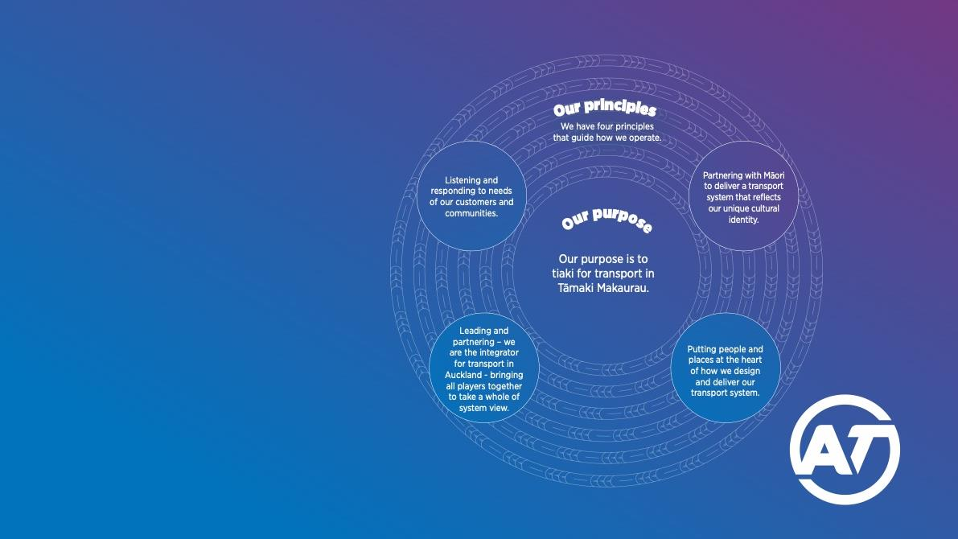
Our principles guide us.

Slide 6
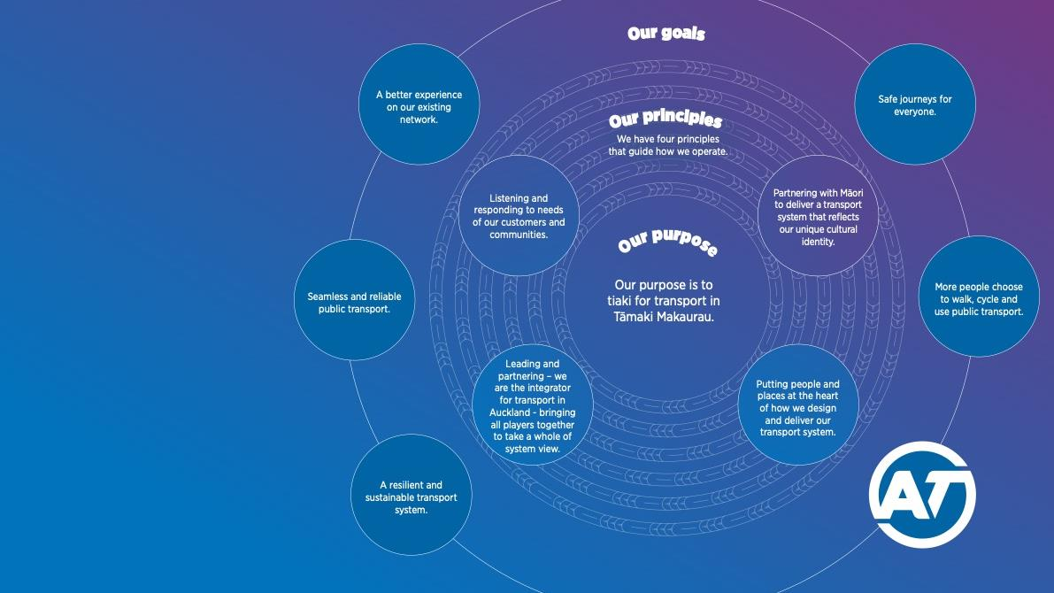
Our goals wrap around our foundation.

Slide 7
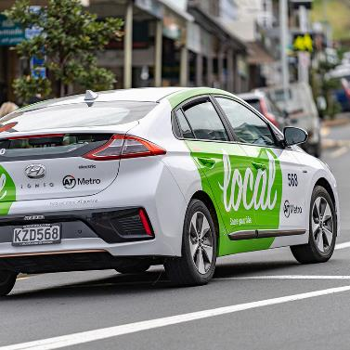
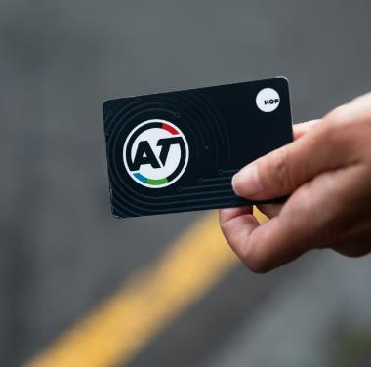

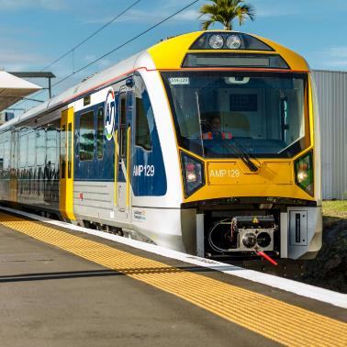
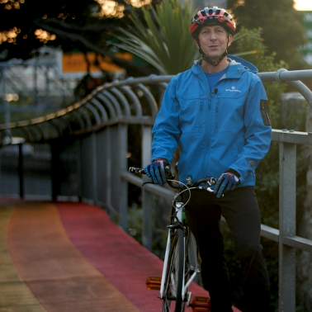
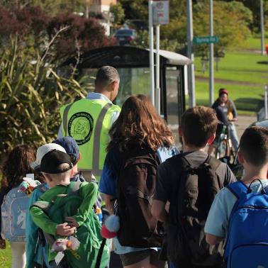
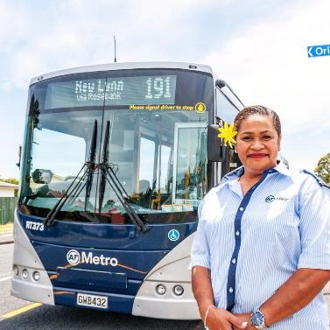
But this is what people see of us.

Slide 8
Tāmaki Makaurau is already an amazing place to live. But we can make our city even better.
From the streets where we live, work and play, to the trains, buses, ferries, roads, cycle lanes, and walkways that connect us.
At AT, we tiaki for transport in Tāmaki Makaurau. This means we are the ones who enable, protect, conserve and support our communities in all forms of transport.
We are here to deliver an integrated system that helps Tāmaki Makaurau unlock its full potential, become more resilient, and thrive.
To tiaki well, it’s important we listen and respond to the needs of our customers and communities.
It’s us working hard with all groups to enable an approach that benefits both Aucklanders, and our visitors.
It’s us caring for our natural environment by playing our part in tackling climate change.
Also putting people and places at the heart of how we design and deliver our transport system.
And using Te Ao Māori to guide our thinking, so we deliver a transport system that improves outcomes for all, and one that reflects our unique cultural identity.
Sticking to these principles will help us tiaki well and together we can achieve our ambitious goals.
A seamless and reliable public transport experience.
Safe journeys for everyone.
Smart use of our existing network.
And, a resilient and sustainable transport system.
We want to achieve these goals so that more Aucklanders have the best options for how ever they would like to get around Tāmaki Makaurau.
Together with our partners, we have the team to do it – our engineers, drivers, wardens, planners and more. We all have a role to play. We all tiaki.
Our purpose is to tiaki for transport in Tāmaki Makaurau.
Let’s live our purpose. And together, we can create an Auckland we can all be proud of.
Our story

Slide 13
Engagement approach
Business Plan
Purpose - Our People - Launch
Org Re-Design
Purpose - Our Partners & Mana Whenua
Purpose - Embed
Strategy into action

