Slide 1
TTM Transformation Programme – Update to DDC
Prepared by Tracey Berkahn & Krishna Nagisetty
July 2023

Slide 2

Introduction

Slide 3
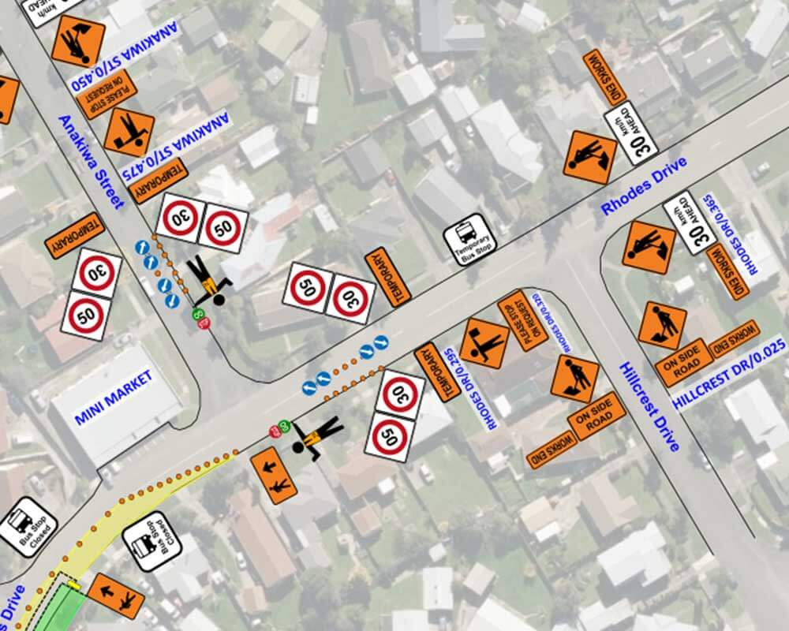
Background
CoPTTM to NZGTTM
The New Zealand Guide to Temporary Traffic Management (NZGTTM) will replace the Code of Practice for Temporary Traffic Management (CoPTTM) in the next two years. This signals a significant systemic change for the practice of TTM in New Zealand. CoPTTM has been in place for 20 years now.
The key change is a move away from a prescriptive set of rules to a more flexible set of guidelines that emphasises planning for and managing risks.
Deliver a better approach to Traffic Management (Mayor’s LoE)
The Mayor, through the letter of expectation has asked that AT delivers a better approach to TTM in Auckland. This also requires a significant systemic change for the practice of TTM in Auckland.
Multiple players – An interdependent system
The TTM system in Auckland is made up of four key players – the Road Controlling Authorities (RCAs), the Principals that create projects, the Contractors that deliver works and TTM companies who in some cases plan and manage TTM around work sites. The systemic change can only be achieved if all these players evolve to meet the challenge.

Slide 4
Moving to risk based TTM is a big change for AT and the industry
The safety net of CoPTTM will be removed. This means no one can rely on that as the best practice standard for risk management at worksites.
AT, as one of Auckland's RCAs, needs to be clear about how it executes the responsibility for Safety expected by the Local Government Act 1974. – Risk management framework
AT as the principal/ PCBU for road construction, maintenance and renewals needs to understand how it executes the responsibility for Safety expected by the Health and Safety at Work Act. – Risk management framework
Private sector partners also need to assume greater responsibility for risk management.
This means creating risk management frameworks, teams with the right skills and demonstrating thought leadership through the transition process

Slide 5
Why we need the TTM Transformation Programme.
Consider the following:
The TTM industry is being asked to respond to the change at a national level. This change being primarily focussed on improved safety within and around worksites.
In addition, in Auckland, the challenge is to find ways to minimise disruption around worksites without compromising safety and to facilitate cost effective TTM solutions.
The principals, the contractors and the TTM companies need to take on the responsibility for their parts (commercial arrangements, site-specific risk assessment, planning and managing TTM) in improving TTM in Auckland.
The change isn’t aligned with everyone’s best interest. The industry players either need to assume more responsibility for risk management and in some cases commercially the change is not favourable. i.e. less TTM = less money.
AT, as the RCA, can lead, enable and encourage change but cannot assume PCBU’s responsibility for risk management within and around worksites.
AT needs to better understand and manage the effects of roadworks on Aucklanders both at a local and regional level.
In summary, we have two major drivers that are complimentary but are not aligned. We need multiple players, with varying levels of incentive, to pull in the same direction with a sense of urgency.
AT is responding by creating a formal programme of work that brings all of these elements together and drives a cohesive and collaborative work plan to deliver the change.

Slide 6
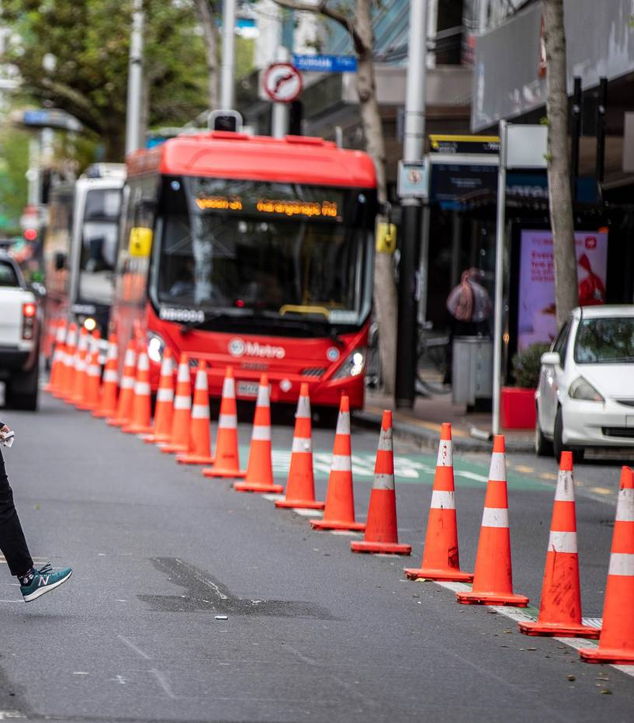
The Programme

Slide 7
The TTM Transformation Programme
Objective: To re-evaluate and redesign the practice of Temporary Traffic Management on our roading network. By doing so, we aim to minimise disruptions to road users while ensuring safety and improved cost effectiveness.
Strategy: Sustainable and meaningful transformation of TTM management in Auckland will be achieved when the whole industry moves to the NZGTTM.
Programme blueprint/ construct :The blueprint in the following slide is organised around this strategy. However, a quick wins workstream is included in acknowledgement that shifting the entire industry will take time and we can deliver value in the short term through specific operational improvements. It also acknowledges that AT ‘s capabilities need to evolve to meet the transformation challenge.

Slide 8
TTM Transformation Programme – Blueprint
 | Current Phase | Q1 FY24 | Q2FY24 | Rest of FY 24 | FY25
Workstream 1 - Quick wins | Design & Delivery | A set of initiatives that contribute to programme objective within the current constraints (and in the immediate future). |  |  |  | Workstream 4 – Communication & Engagement Initiatives focussed on communicating, educating and engaging with the right internal and external stakeholders at the right time. This workstream supports all the other three workstreams.
Workstream 2 - Industry transition | Investigation & Design | A cohesive work plan to enable whole of industry transition to risk based TTM.
Workstream 3 – Enabling AT | Investigation | This workstream will focus on improving AT's culture and capability to support the TTM Transformation programme.

Slide 9

The Initiatives

Slide 10
Quick Wins – Initiatives
This workstream is in Design & Delivery phase.
Initiative Name | Description | Status | Commentary
Redundant TTM clean up | The initiative aims to clean up redundant TTM equipment on our network. In many cases, this is created as a result of projects/ contractors leaving behind equipment after a project is complete. | Live | Customer can report redundant TTM to AT through our website. Our team are also proactively auditing the network to identify redundant TTM. We continue to work with the contractors to carry out the clean up through various tactics.
Weekly city centre walkaround | AT walks a different part of the city centre each week to identify opportunities to optimise worksites. | Live | All identified opportunities are then communicated with the respective projects to implement corrective actions.
CCTV monitoring trial | Roadwork sites on K-Road, Quay street and Queen street are monitored via our CCTV network multiple times a day. | Live | This trial will run for 3 months so we can create an exemplar of TTM monitoring for future consideration.
RCA Fee review | We are proposing to amend the Corridor Access fee schedule to recover the cost of providing this service. | Consultation | We have taken this opportunity to structure the fee schedule in a way that it incentivises the right behaviour by the applicants. Planned to go to live by end of September 2023.
Lowering TTM requirements in low-speed environments | This initiative aims to change TTM requirements for roads categorised as Level 2 (or below under COPTTM) in low-speed environments, with a view to reducing current Level 2 roads to lower minimum requirements. | Design | Once complete, the contractors and TTM companies will be able to plan for a lower standard of TTM set up, on some urban roads (approximately 130 km). Planned to go live by end of August 2023.
3 strike system | An initiative to drive better conformance by contractors and/or TTM companies operating worksites on AT’s network. | Design | Refined and relaunched by end of October 2023.
Making the most of AT’s resource | This initiative explores how AT’s large mobile work force might contribute to this programme. | Investigation | We are in very early stages of this initiative.
Priming the Industry | Signal AT’s intent to transform the practise of TTM in Auckland. | Complete | We have invited the industry to apply trials and/or innovative approaches to TTM via industry newsletter, partnership forums and industry get-togethers. We are also pro-actively partnering with some worksites to trial transformational TTM practices

Slide 11
Industry Transition – Phases & Initiatives
This workstream is in Investigation & Design phase.
AT is playing a leadership role in the industry transition to risk based TTM . We expect this to be at least a 2-year process. All relevant organisations need to understand their obligations under the risk-based approach, changing roles of others in the ecosystem , skillset required, and operating systems required.
This transition has three phases – Initiate the transition, Facilitate the transition & Sustaining the new way. We are currently in the initiate phase and expect this phase to be completed by end of Q2 FY24.
  Initiate the transition: This phase is currently underway and includes:
  Facilitating the transition: Deliverables and duration of this phase will depend on the outputs of the initiate phase. (likely to include developing new process and procedures, training our teams, running industry forums etc)
  Sustaining the new way: This phase will include monitoring the performance of the new risk-based system, making adjustments/ trouble shooting and communicating the benefits to all key stakeholders.
Initiative | Commentary
Conducting trials to test the risk-based approach | AT is supporting several contractors to conduct NZGTTM trials for specific types of activity in the road corridor. These trails will give all parties an understanding of what it takes to implement this risk-based approach.
Engaging with the industry to understand their needs and concerns | This has started and will continue as an iterative approach.
How does AT execute its legislative responsibilities when the industry moves to risk based TTM and in absence of CoPTTM. | Currently in investigation phase. We will workshop this with AT’s leadership and governance teams.
Gaining commitment from the industry to the transition | We are setting up an AT led workshop with the industry members and bodies to work on these deliverables.
Clarifying the roles and responsibilities of all parties involved
Co-designing the transition plan with the industry

Slide 12
Enabling AT – Focal Areas
This workstream is in Investigation phase.
AT plays two roles, as RCA and a Principal in relation to TTM in Auckland. This workstream aims to deliver initiatives that enable AT to:
Better understand and manage the effects of roadworks on Aucklanders both at a local and a regional level
Better fulfil it’s obligations as the Principal at worksites
We are in the early stages of investigating this workstream. As such, we do not have a list of initiatives. However, we will explore the following broad areas for improvements.
Processes
What processes and procedures need to be changed, introduced or phased out?
Organisation
This focus of this area is our People. The scope for this area include (but not limited to):
Technology & Tools
The focus of this area is systems, tools and technology that better enable how we operate and provide service.
Management Information
The focus of this area is data, analytics and reports that enable better decision making.
1. Culture
2. Skill requirements
3. Which team does what?
Given the proportion of operating processes that are manual, there is a lot of opportunity for technology to make significant difference.

Slide 13
Communication & Engagement
This workstream is in Initiation phase.
This workstream will support delivery of all other workstreams. We are currently working to secure the right skillset and start the planning process.
Any communication and engagement plan has to take the following audiences into account:
Aucklanders – we need to tell Aucklanders what AT is doing to improve TTM management in Auckland. This has to take into account other workstreams within AT that are working in the same space.
Auckland Transport - an internal campaign is needed to create awareness, engage, educate and support implementation of changes.
The TTM industry – we need a well-designed campaign to engage with the industry and have them come with us on the transformation journey.
Elected Members – we need to keep our elected members informed of how we are progressing with this work programme.

Slide 14
Key Risks & Issues
Name | Description | Mitigation
Budget (I) | Currently there is no specific budget allocated or identified for this programme of work. This puts limitations on what resources can be deployed to deliver the programme. | Work is underway to estimate budget requirements and to identify possible budget sources, including higher revenue generated as a result of fee review implementation.
Human Resources (I) | We currently have approximately 0.80 FTE (in addition to operational teams) available to work on this programme of work. This again puts limitations on how quickly and effectively work can be completed. | A programme secretary is brought onboard effective 23rd July 2023. Work is also underway to secure Comms & engagement resource, as well as co-design resource. Further mitigation is dependant on mitigating the budget issue.
Poor engagement by the TTM industry (R) | The industry might not engage with the transformation programme, either because the transformation calls for better risk assessment and planning or because it is not commercially favourable. | Establishment of a work stream dedicated to engaging and co-designing the transformation with the industry. AT, as the PCBU, takes lead.
Unrealistic expectations (I) | Public expectation and political expectation do not match with what AT can achieve both from a legislative perspective or our ability to influence the industry. | Education, communication and stakeholder engagement.

Slide 15
Thank You

