Slide 1
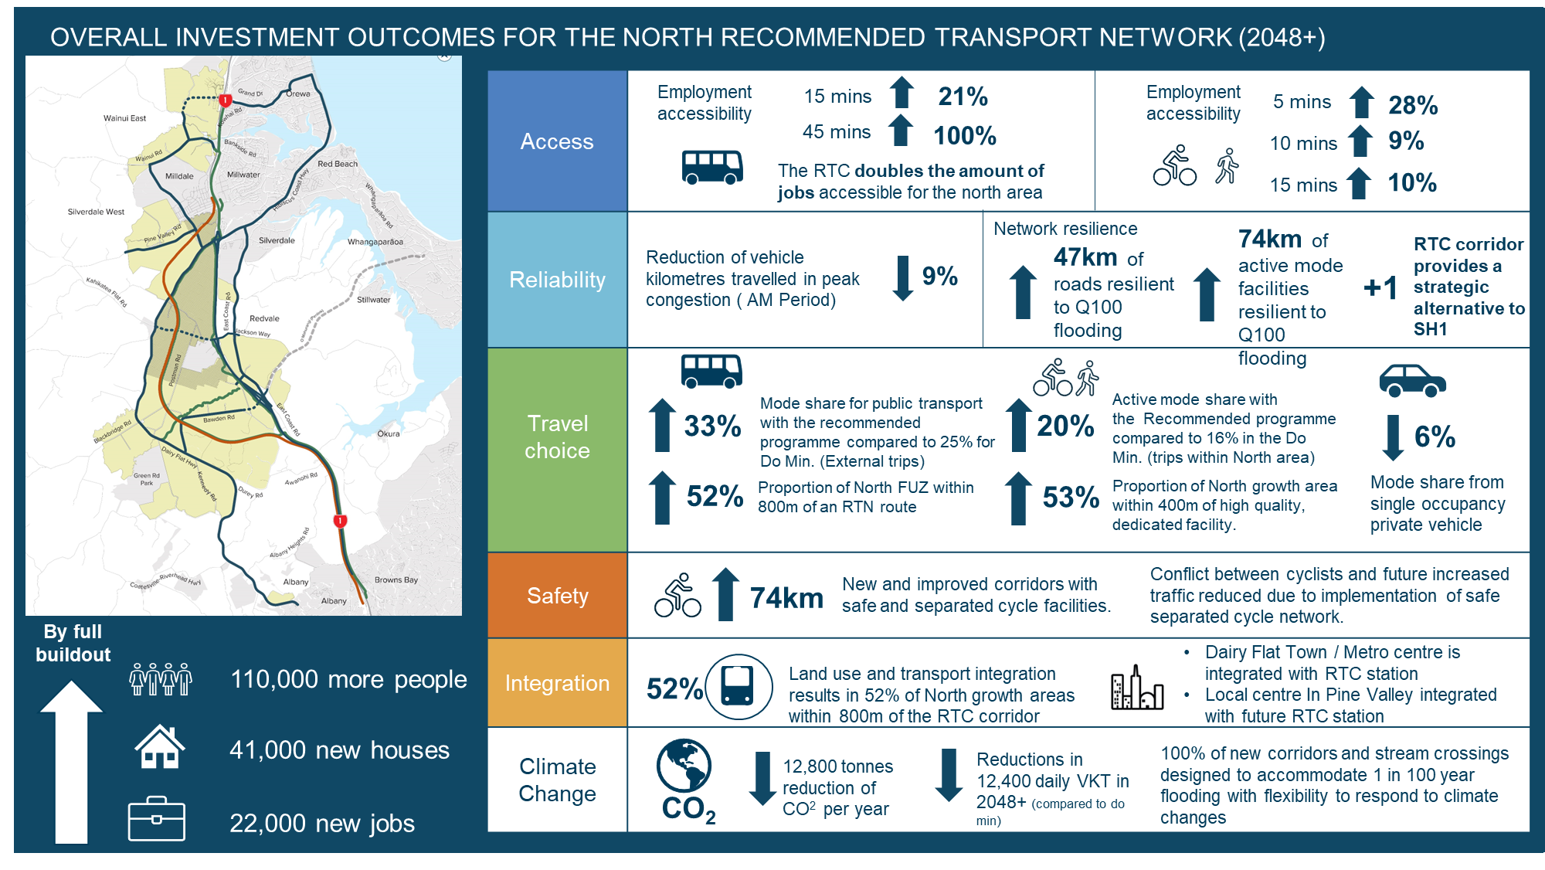
Attachment 3 - Key outcomes of Strategic Transport Network (2048+)

