Slide 1
Future Connect 2023: Summary Document
Attachment 1
Revised version of Auckland’s Strategic Network Guidance
September 2023

Slide 2
What this is
Future Connect is a core guidance resource which represents the whole-of-system view of the network. It maps the most important links for all modes, analyses these networks to map key challenges, and inform investment planning decision-making. Future Connect was developed in 2020 and first published in 2021.
Why are we talking about it: Future Connect has been updated in preparation of work commencing on the 2024-2034 Regional Land Transport Plan.
Outline of this pack
Overview of Future Connect
Changes and improvements
Summary of key findings

Slide 3
1. Overview of Future Connect
Future Connect 2023

Slide 4
GPS - Government Policy Statement on Land Transport
What is Future Connect?
Auckland Plan 2050
AT’s whole-of-network view
A key planning tool and evidence base that builds on and synthesises higher-order plans like the Auckland Plan and guides the development of the RLTP and subsequent project planning, design, delivery and operations.
An online mapping portal highlighting three key outputs:
  Strategic Networks for all modes of transport
  Transport System Analysis, highlighting issues and opportunities
  Focus Areas for investment, our key challenges to overcome
Future Connect currently has a ten-year horizon and displays both the current and future state of the networks.
A summary of Future Connect and its part in the system planning process for transport in Auckland is shown to the side.
ATAP – Auckland Transport Alignment Project
Other AT plans (RPTP Room to Move etc)
RLTP – Regional Land Transport Plan
Future Connect
RASF – Roads and Streets Framework
NOP – the Network Operating Plan
Asset
Mgmt Plan

Slide 5
How Future Connect works
We map our strategic networks, analyse them, and distill our key challenges
Strategic Networks
Current
First Decade
The most important links for the movement of goods and people across the region, now and considering future growth and plans
System Analysis
Issues
Opportunities
Using current and forecast data to map issues and opportunities for all modes and the three intermodal problems: safety, environment and equity
Focus Areas
Bringing all the data together into a map of key regional challenges

Slide 6
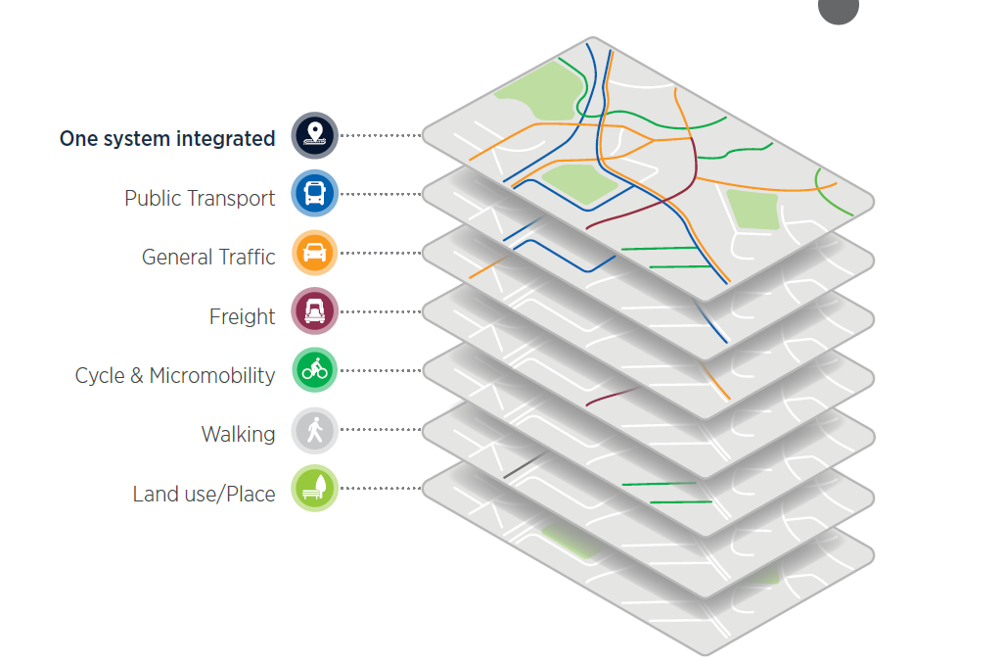
Why did we update Future Connect
We need to update Future Connect in preparation for the next Regional Land Transport Plan, and to ensure it stays up to date.
In August 2022, we informed the ELT and the AT Board that work had started on updating Future Connect for the following reasons:
A new version of Future Connect is needed to support the development of the 2024-2034 RLTP.
Networks needed to be updated in response to latest plans, projects and strategies.
We had identified improvement opportunities after using the tool for some time.

Slide 7
2. Changes and improvements
Future Connect 2023

Slide 8
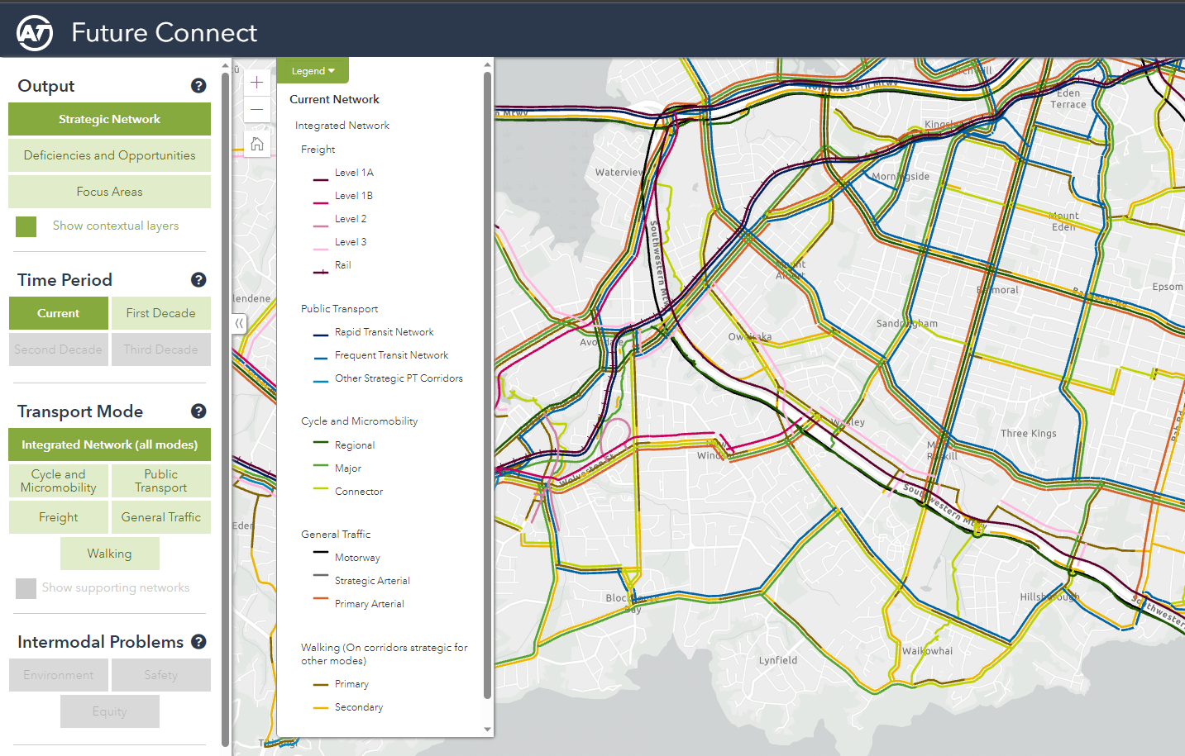
What changes and improvements did we make?
Mapping Portal Updates
Updated all three key outputs:
  Strategic Networks, shifting from 2021-2031 to 2024-2034
  Improved system analysis with new data and indicators, as well as greater distinction between deficiencies and opportunities
  Focus Areas now tell a more compelling story about Auckland’s key challenges
We’ve moved beyond corridor analysis and consider community needs, in the form of a Transport Equity Analysis.
Fully incorporated the walking network, which was separate in the 2020 version and did not have a full deficiency analysis done.
Incorporated outputs of the RTN Station Access Study
Added contextual data to mapping portal, allowing for the easy creation of maps
Report Updates
Refresh of Summary Report
Refresh of Technical Report

Slide 9
3. Key findings and outputs
Future Connect 2023

Slide 10
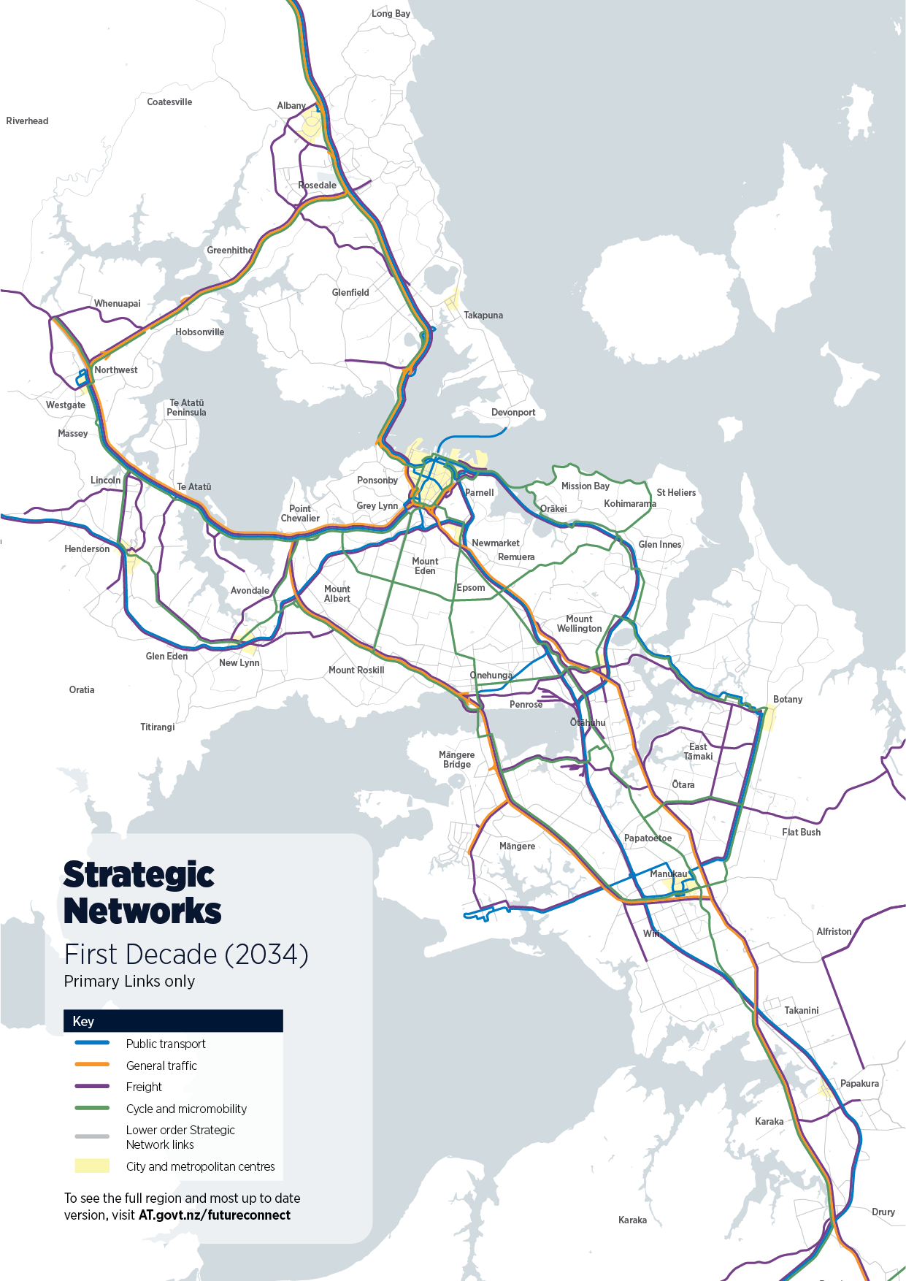
Strategic Networks
System Analysis
Focus Areas
In Future Connect 2021, networks were based on
Existing plans, such as the Auckland Plan, 2018 RPTP, 2018-2028 RLTP, The Freight Plan, and the Cycle and Micromobility Network
The first-decade networks were informed by expected RLTP projects and greenfield/brownfield growth.
In Future Connect 2023 we’ve updated these networks to
Show how the network changes from 2024 to 2034, instead of 2021-2031, the period covered by the original version of Future Connect
Reflect newly delivered projects (Puhoi to Warkworth, Eastern Busway Stage 1, etc)
Incorporate new thinking coming out of business cases (Cycling SSBCs, Supporting Growth Alliance, etc)
Reflect new plans and strategies (2021-2031 RLTP, Draft RPTP)
Our strategic networks are expected to grow by 8%, or 260 km, over the next ten years.

Slide 11
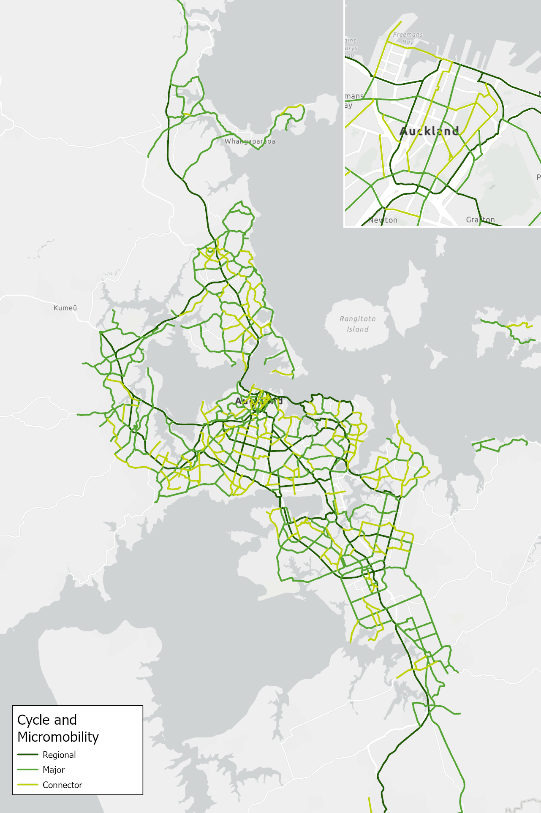
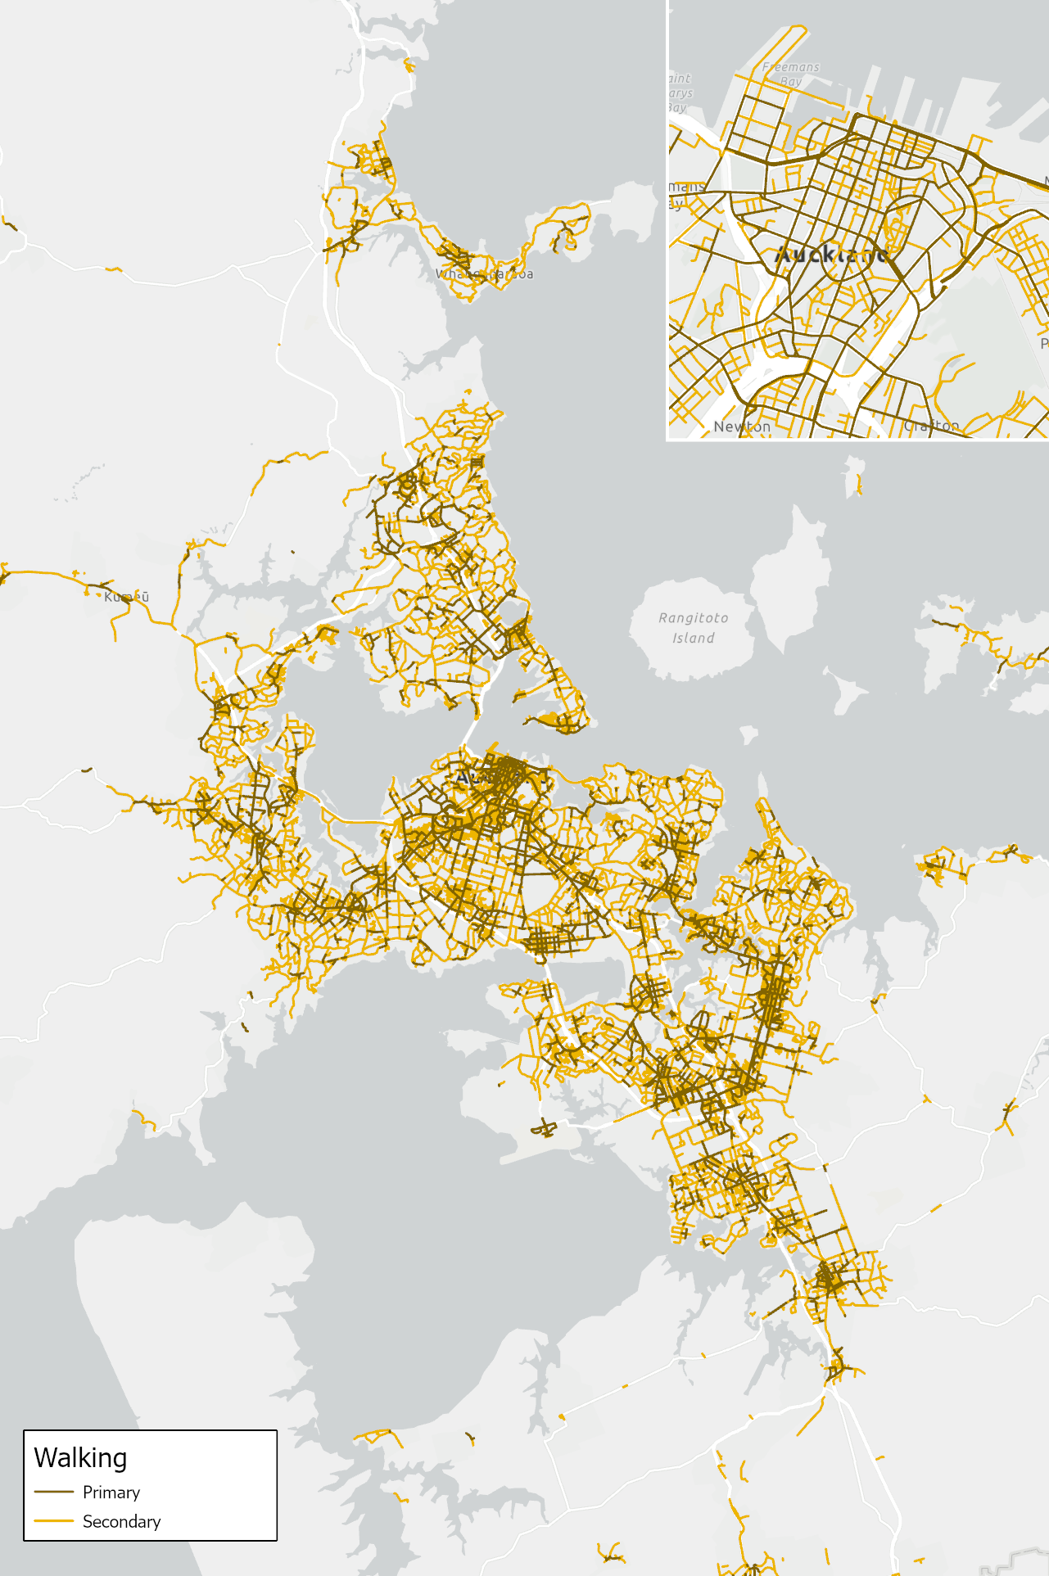
Strategic Networks
System Analysis
Focus Areas
This and the following slide provide an overview of the full updated 2034 Strategic Network for each mode covered by Future Connect.
Supporting Networks (lower order links) for each network are not pictured, but are included in the GIS portal.

Slide 12
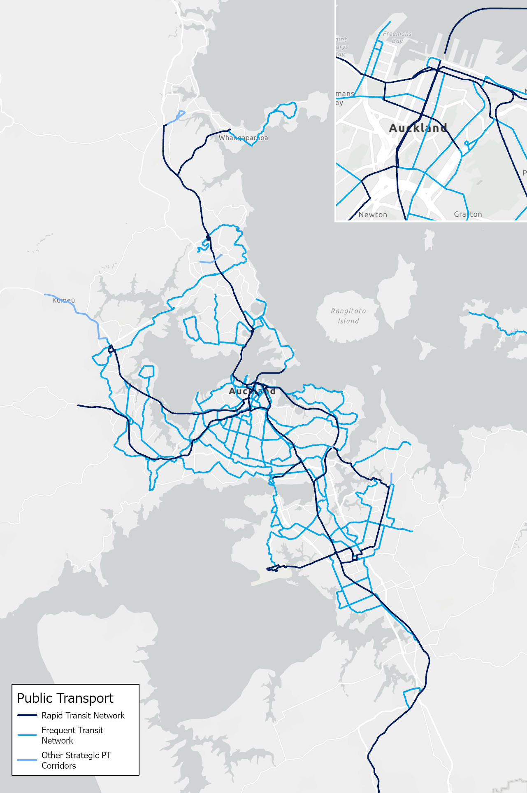
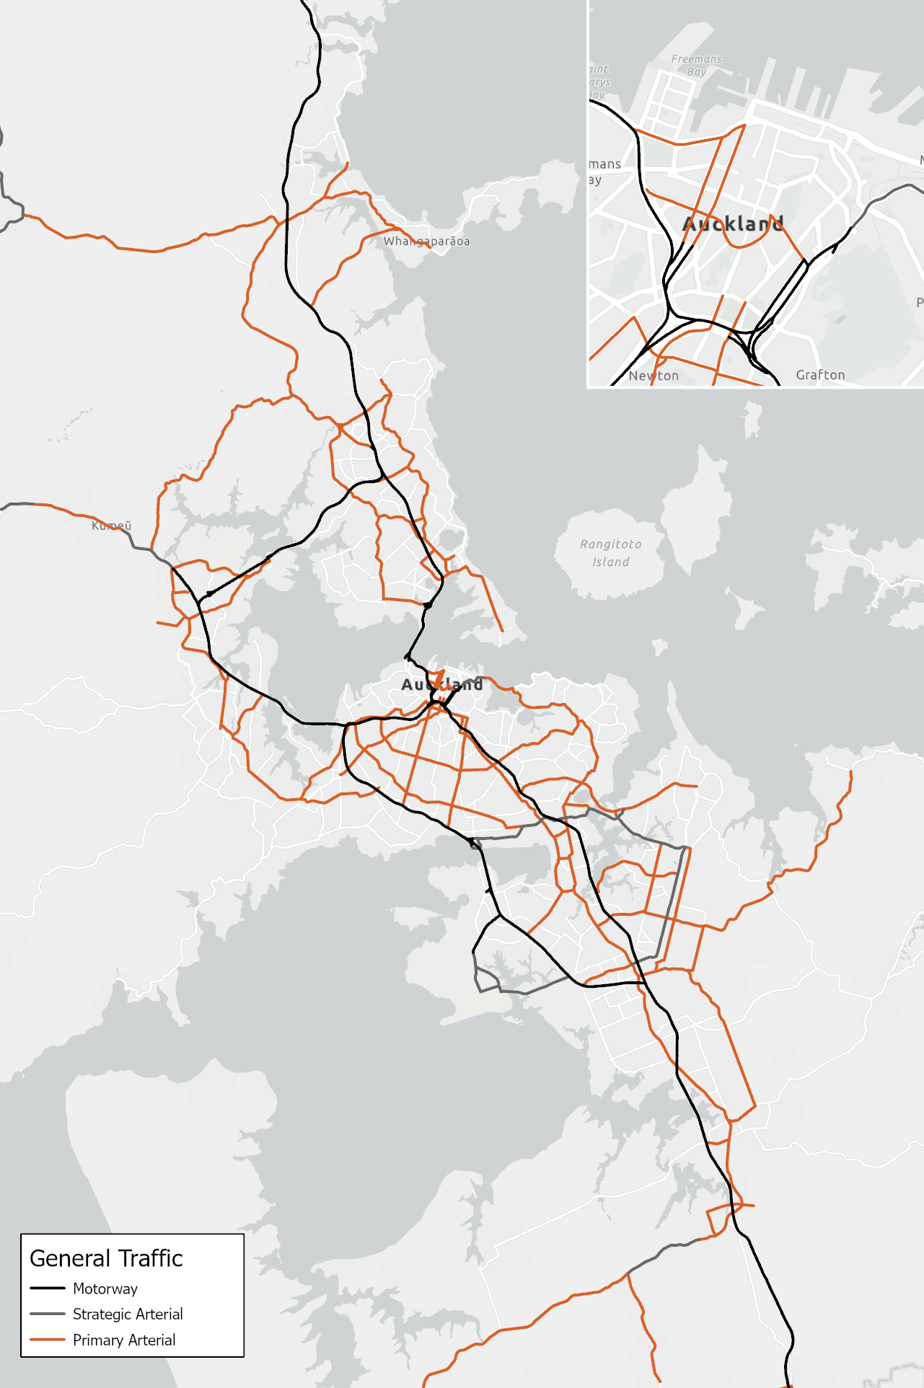
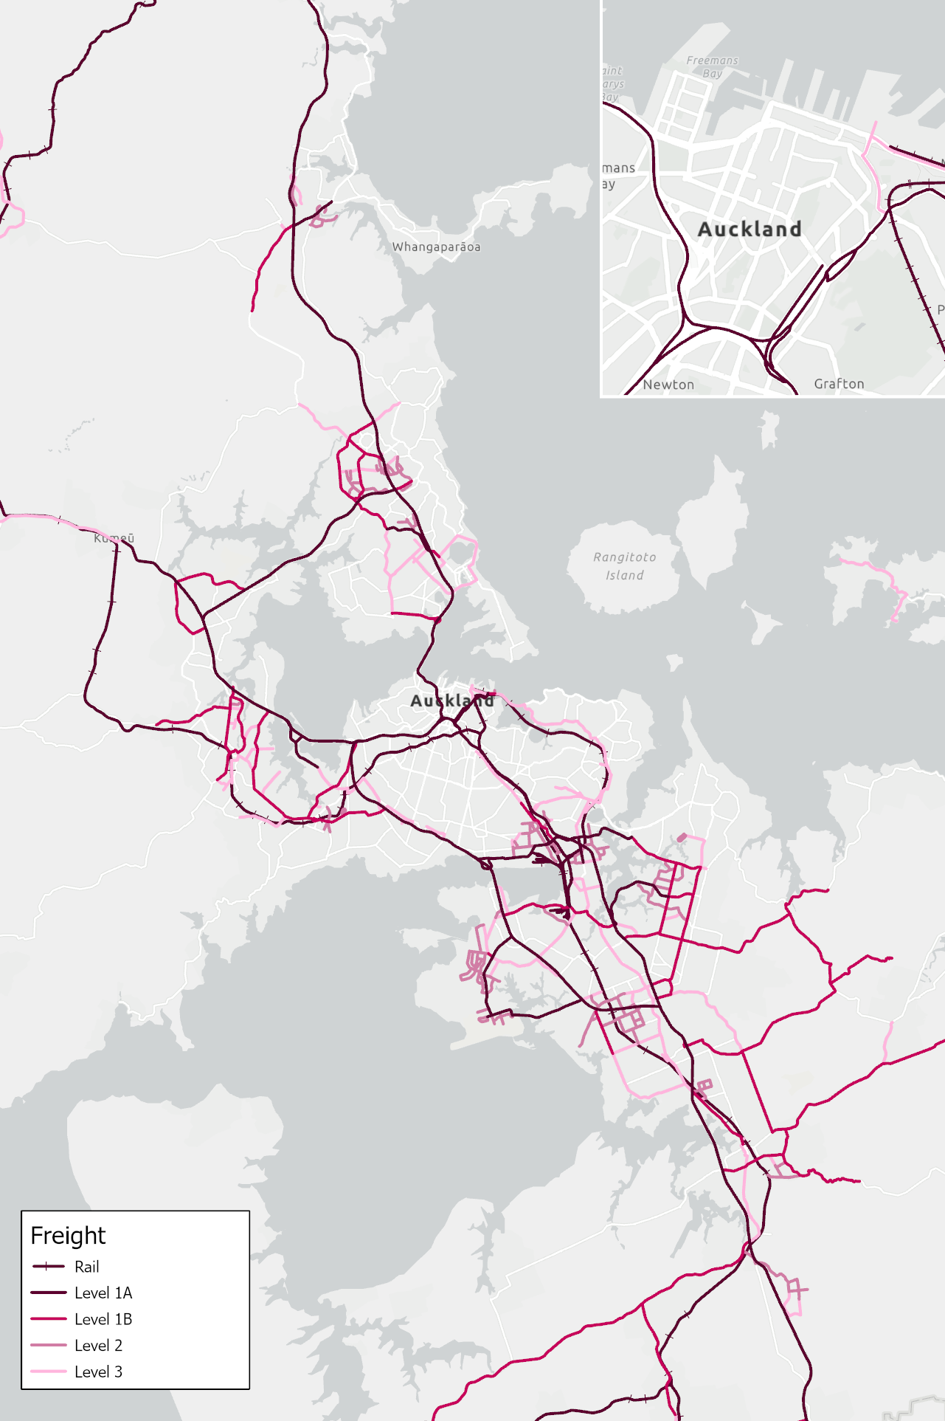
Strategic Networks
System Analysis
Focus Areas

Slide 13
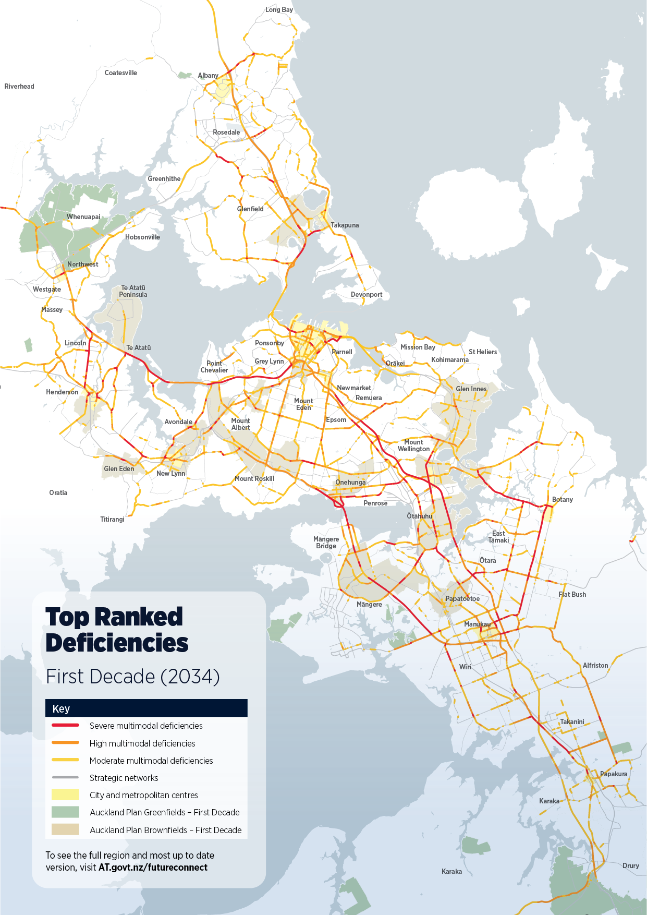
Strategic Networks
System Analysis
Focus Areas
2034 Multimodal Deficiencies
Mapping existing deficiencies, and what gets worse in 2034
Using 20 Indicators, several for each mode, and two intermodal problems (safety & environment)
Current and forecast data, to identify where things are bad, and where they get worse
In Future Connect 2023, we’ve updated our indicators to use newer and better data.
Deficiencies are only mapped on Strategic Network Links.
For each mode, the severity of the deficiency is ranked using the strategic network hierarchy.
Future Connect also maps opportunities for each mode, to highlight where proactive investment can be most beneficial.
Multimodal Deficiency Map
Ranked deficiency scores for each mode and problem are added together into a ‘Multimodal Deficiency Score’ (shown to the right) that indicates corridors with multiple significant deficiencies.
These corridors have a few high-ranking issues, or many smaller ones.
The Future Connect Mapping Portal allows users to easily switch between this deficiency map and individual maps for each mode/problem, to see why corridors are coming up as deficient.
The deficiency analysis provides a useful evidence base for those working on Auckland’s future transport network.

Slide 14
Strategic Networks
System Analysis
Focus Areas
High level summary of data considered for each mode and problem
Public Transport | Walking | Cycling
Deficiencies AM and PM Speed Level of Service AM and PM Reliability Level of Service Patronage/Capacity Ratio changes (forecast) Opportunity Routes identified for service improvements in the RPTP | Deficiencies Footpath width compared to TDM Standard Distance between priority crossings on busy roads Opportunity Footpaths inside intervention areas identified in the Walking Programme Business Case | Deficiencies Unsafe or no facilities Opportunity Routes without facilities in the catchment of centres, schools, RTN Stations Routes without facilities connecting to built/committed facilities
Public Transport | Freight | Environment
Deficiencies AM and PM Speed and Productivity Level of Service AM and PM Reliability Level of Service AM and PM volume/Capacity Ratio changes (forecast) | Deficiencies AM and Interpeak Speed Level of Service AM Volume/Capacity Ratio Changes (forecast) Opportunity Routes with significant forecast freight volumes | Deficiencies Untreated Stormwater Runoff Coastal Erosion and flooding risk Opportunity High place value areas with high heat vulnerability and few street trees.
Deficiencies: where our customers or the environment experience outcomes that fall short of AT’s strategic objectives, either now or in the future.
Opportunities: where proactive improvement initiatives would likely achieve the highest impacts on customer experience, environment, or other strategic outcomes.
Safety
Deficiencies Urban KiwiRAP Collective Risk Urban KiwiRAP Active Road User Risk

Slide 15
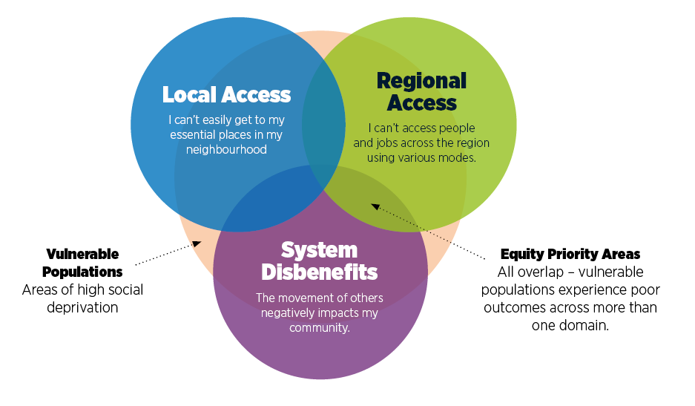
Strategic Networks
System Analysis
Focus Areas
Transport Equity
A new intermodal problem, based on the draft Auckland Transport Equity Framework, investigating how transport outcomes are distributed across the region
Follows a high-resolution GIS analysis that measures regional transport outcomes for across three domains:
  Local Access (key destinations in community),
  Regional Access (jobs and people using various modes), and
  Transport System Disbenefits (negative impacts such as safety risk)
Multiple measures, surfaced through research conducted within the Auckland Transport Equity Framework, were considered for each domain. Measures include distance to nearest PT stop, access to population via PT, or percentage of roads with high safety risk in local area.
Different measures for Rural and Urban areas, as travel behaviors differ. Urban measures have a stronger focus on walking, cycling and PT.
We want to know where vulnerable people experience poor outcomes across one or more of these domains.

Slide 16
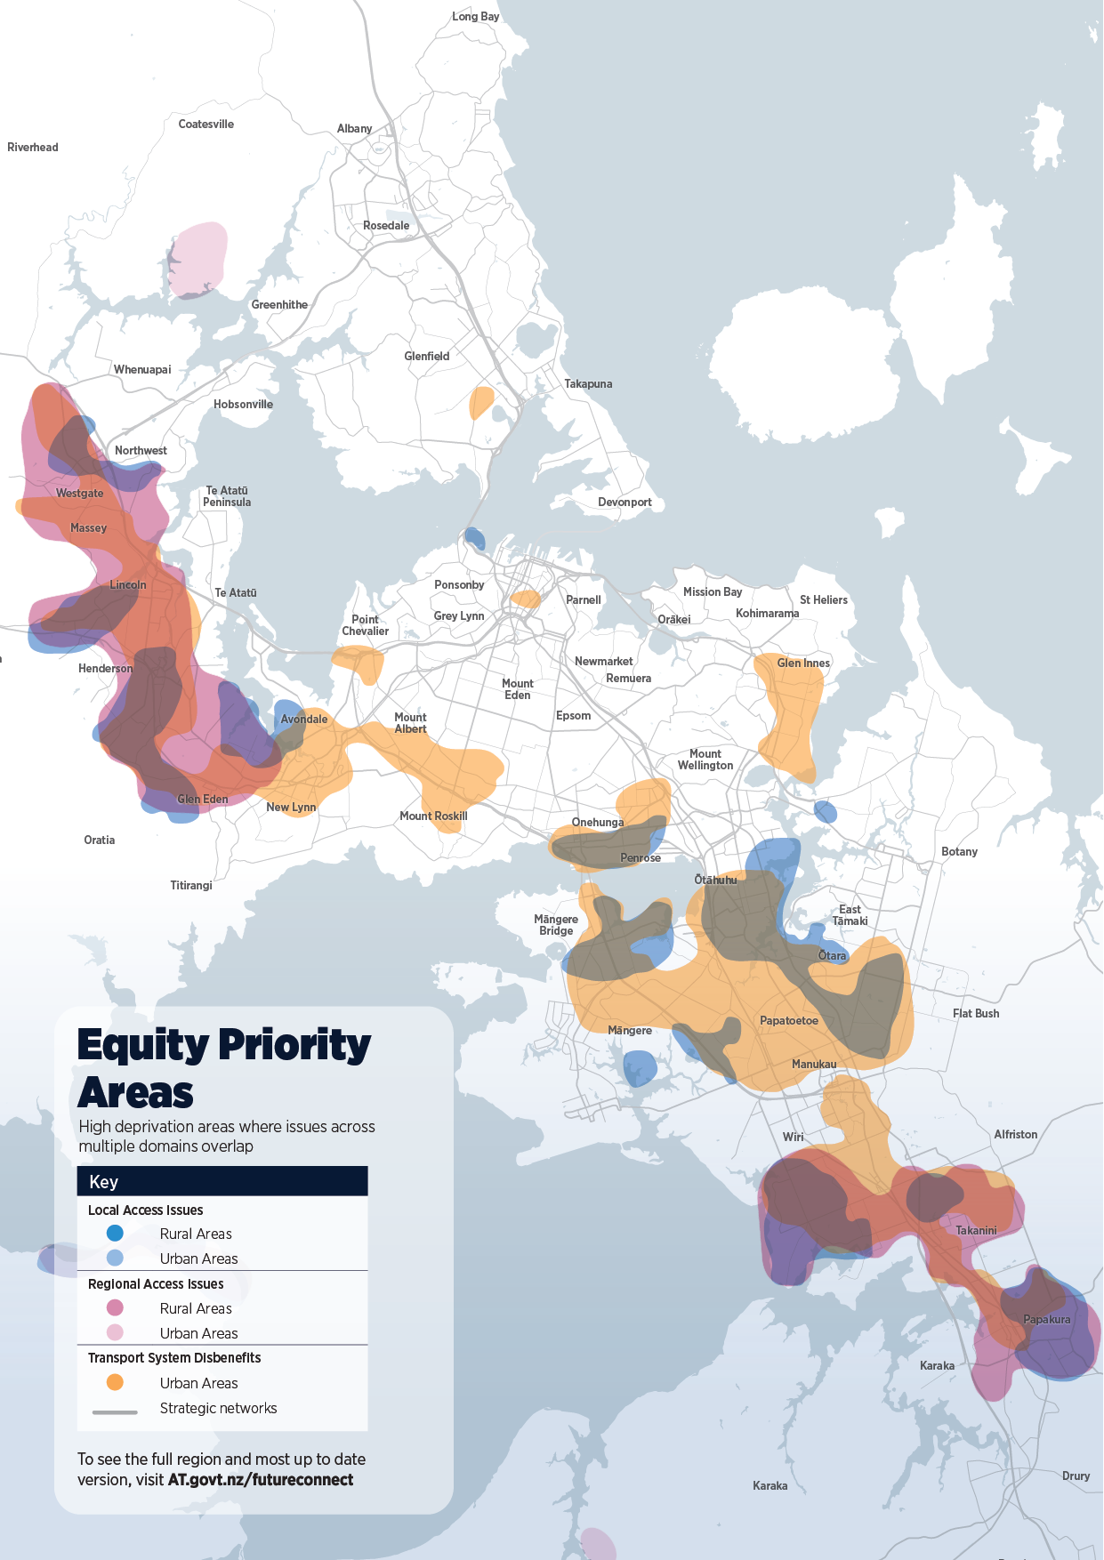
Strategic Networks
System Analysis
Focus Areas
Key findings
Not all High Deprivation Areas have transport problems, and not all transport problems affect people in high deprivation areas
However, people in high deprivation areas may lack the means to overcome barriers put up by the transport system; especially when poor outcomes across multiple domains are experienced.
The map to the right highlights high deprivation areas that experience poor outcomes across one or multiple domains of transport equity.
Priority Areas across the region
West and South - It’s difficult to walk and cycle to local destinations, and people can’t access jobs and population. People also experience noise, safety and severance issues.
Closer to the city – Although Regional Access is better, poor local access and transport system disbenefits are found in many high deprivation areas.
Certain rural areas are impacted too, although the share of the population living in these areas is small.
The equity analysis will help us prioritise investment in communities that are most at need

Slide 17
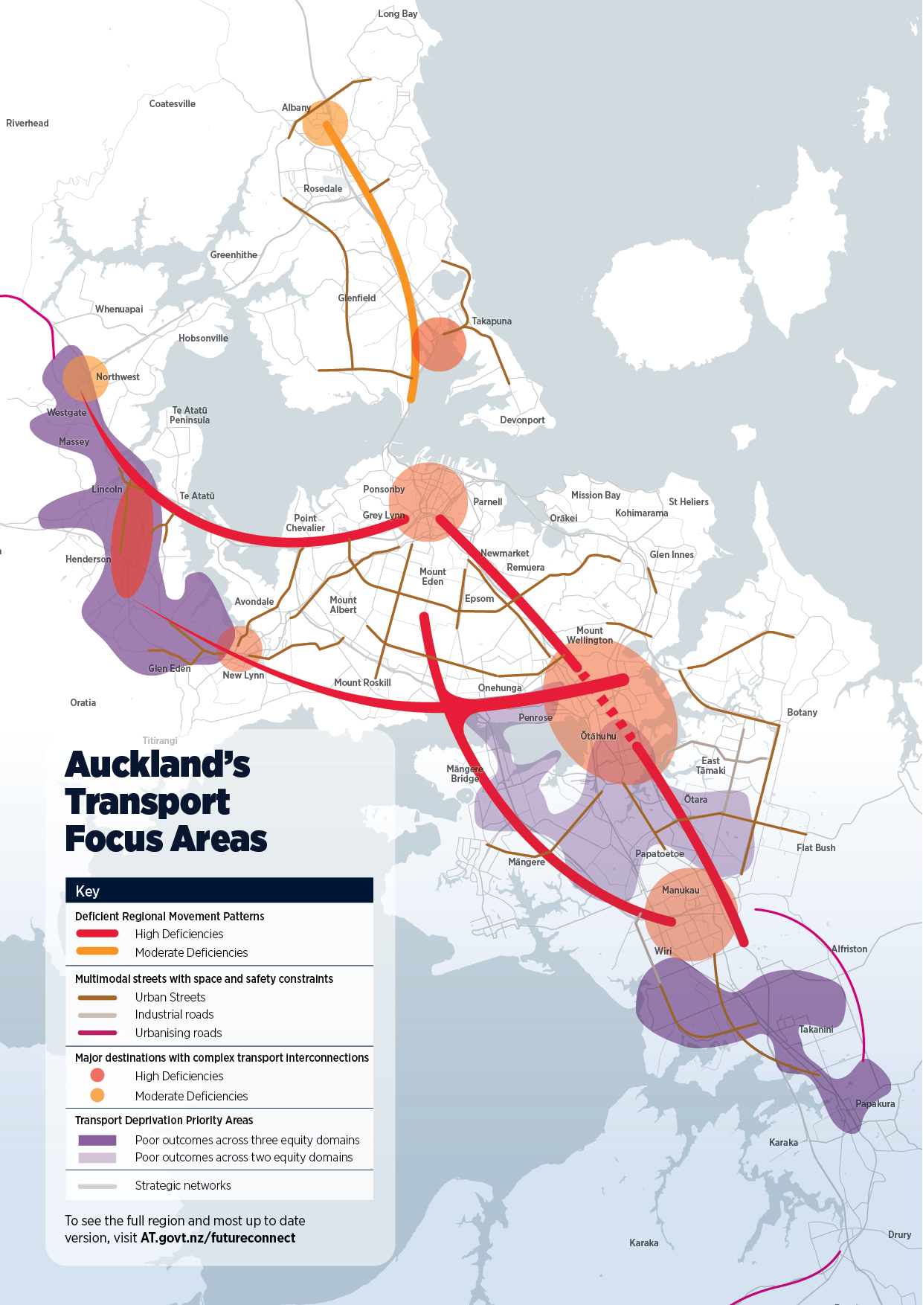
Strategic Networks
System Analysis
Focus Areas
Bringing together all the data into a map of key regional challenges
Four key themes stood out
Deficient Movement Patterns
  Key regional commuting flows
  Often reliant on congested and worsening general traffic networks with high safety/environmental risks and limited competitive alternatives
  Likely to require significant central government investment
Multimodal Streets with Space and Safety Constraints
  Local Roads that are relied upon for several modes, with high deficiencies for many.
  Often historical corridors with land use interactions further impacting movement function.
Major Destinations with complex transport interconnections
  Key hubs around the city where people work and study
  Regional and local transport networks interchange
  Land use interactions further complicating movement function
Transport Deprivation Priority Areas
  Areas experiencing poor outcomes across two or three equity domains

Slide 18
Thank you

